Slide 1
Unit 1 People of achievement
Reading and Thinking

Slide 2
Teaching objectives:
By the end of this period, you will be able to…
1. figure out the structure of the passage by analyzing the main idea of each paragraph.
2. identify the useful patterns and expressions about how to describe a great person and use them to express opinions.
3. learn about Tu’s lives and deeds and analyze Tu’ s characters.
4. express their attitudes towards Tu’s choices.

Slide 3
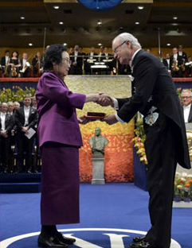

Pre-reading
Unit 1
People of Achievement
Look & discuss
She is Tu Youyou.
Tu Youyou received her prize from King Carl XVI Gustaf of Sweden during the Nobel Prize Awards Ceremony at Concert Hall in Stockholm(斯德哥尔摩), Sweden.
1. Who is the woman in the photo?
2. What is happening in this photo?
3. What more can you find from this photo?
She is being awarded Nobel Prize.

Slide 4
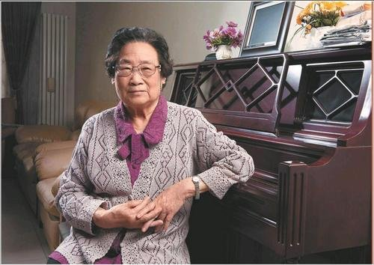
While-reading---Prediction
2
TU YOUYOU AWARDED NOBEL PRIZE
6 October 2015
PART

Slide 5
While-reading---Prediction
Who?
What?
Tu Youyou
Why?/For what?
How?
When?
Awarded
Nobel Prize
What?
For what?
From the title and the pictures, we can know that the passage might be about ___________________________
the life story of Tu Youyou and the process of the discovery of artemisinin.

Slide 6
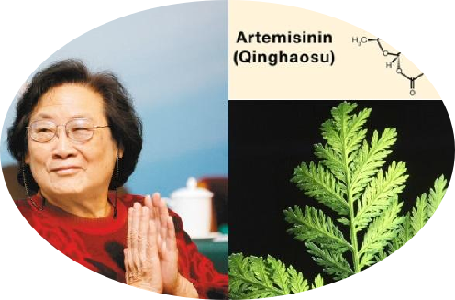

What did she discover?
When did she discover it?
She discovered a new revolutionary treatment for malaria(疟疾)—artemisinin (青蒿素).
About 1971.
 Tu Youyou, Chinese Chemist
 Winner of the 2015 Nobel Prize in Physiology or
Medicine.
 She was nominated by the BBC as one of the most
influential figures in 20th century science alongside
Marie Curie, Alan Turing, and Albert Einstein.
 Recipient of the Medal of the Republic（共和国勋章）.

Slide 7
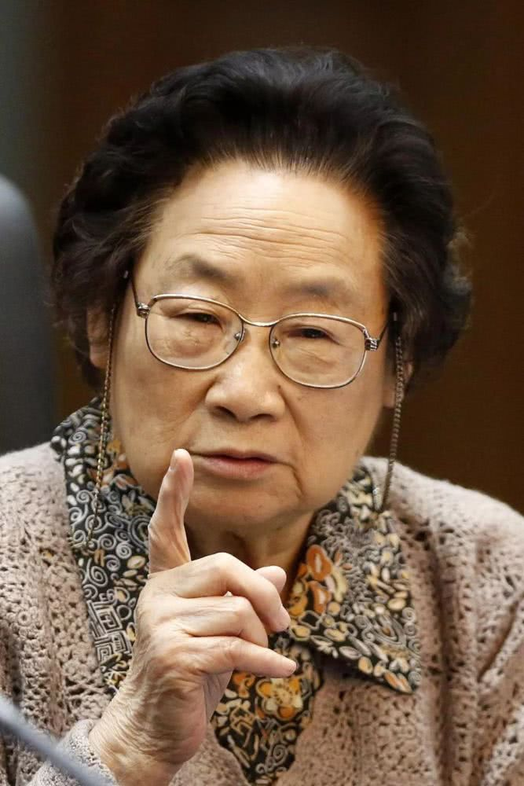
Reading for main thread of the text.
a
GIVE MAIN IDEAS
1. Paragraph1:
2. Paragraph2-3:
3. Paragraph4:
Why Tu Youyou won the Nobel Prize in 2015
How Tu Youyou's team discovered artemisinin.
How Tu Youyou responed to her winning of the Nobel Prize.

Slide 8
b
Circle the answers to the questions below.
D
Where would you most likely find this passage?
1
A, In a blog B. In a book C. In a letter D. In a newspaper
A
C
Passage like this are most often written in _____ and _______?
2
A. the active voice/ offer many opinion
B. the first person/ talk about feelings
C. both active and passive voices / mostly contain facts

Slide 9

Which two pieces of information were not included in the passage?
A. A quote from Tu Youyou
B. The details of how artemisinin was discovered
C. Tu Youyou's important contributions other than the discovery of artemisinin.
D. Tu Youyou's personal life.
E. Tu Youyou's road to discovering artemisinin
F. What Tu Youyou was awarded.
G. Why artemisinin is an important discovery.
3

Slide 10
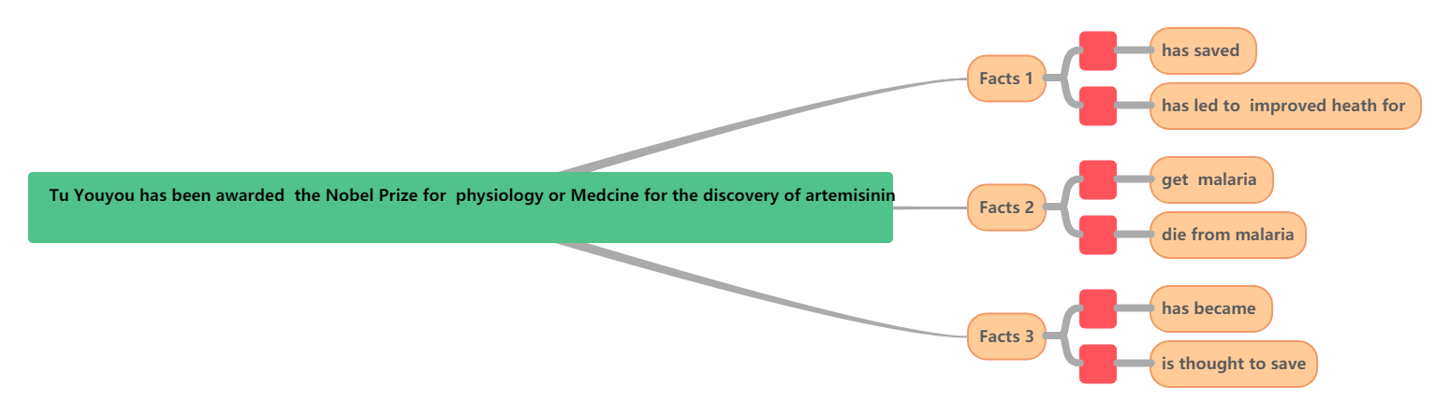
c
Circle the answers to the questions below.
1. Where would you most likely find this passage?
The importance of discovering artemisnin
News
1
2
3
4
5
6

Slide 11
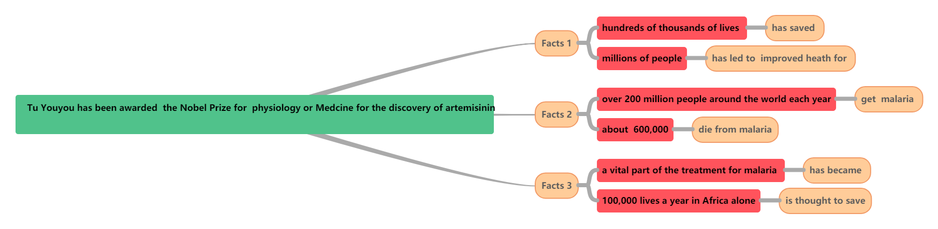
c
Discuss why the discovery of artemisnin is important
1. Where would you most likely find this passage?
The importance of discovering artemisnin
News

Slide 12
2. Scan paragraph 1 to find two adjestives describing the discovery of attemisinin.
vital；crucial

Slide 13

3 Fill in the blanks and outline the life of Tu Youyou.

Slide 14
Who - Tu Youyou
Part 1
Why great – won ________ in 2015, which lead to the _______ of artemisinin
Nobel Prize
discovery
1930 - ____________ in Ningbo
born
1955 - __________from Peking University Medical school
graduated
Life experience
The life of
Tu Youyou
1967 - formed a team to find new treatment for_____
Part 2
malaria
1969 – became the ______ of the project…
head
1971 – finally _________ in the experiment
succeed
2015 – won the ___________
Nobel Prize
Tu Youyou’s response to the Nobel Prize
Part 3

Slide 15
Post- reading
1.How was artemisinin discovered?

Slide 16

over 2000
They found a medical text suggesting ____________________________________________
Tu's team examined _________,
_______________and evaluated ________________________
old medical texts
using the extract from sweet wormwood
to treat a fever.
8,000 plants for properties.
What was the key to getting a good extract from the wormwood?
dried wormwood
They tested ________________
__________________________
a standard
leaves but found no effect
The medicine became _________
___________________ .
treatment for malaria
How was artemisinin discovered?
boiling fresh wormwood
They tried _________________
_________________but______
________________
They tested the medicine on
_______________.
and using the liquid
this did
malaria patients
not work either.
on
They tested the medicine____ _________ to see if safe.
They used a ________________
__________ the sweet wormwood
contract.
lower temperature
themselves
to draw out

Slide 17
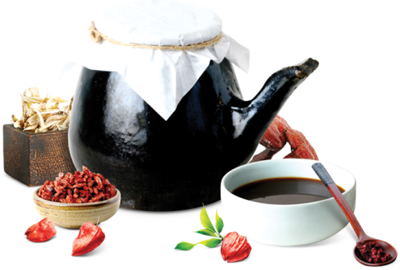
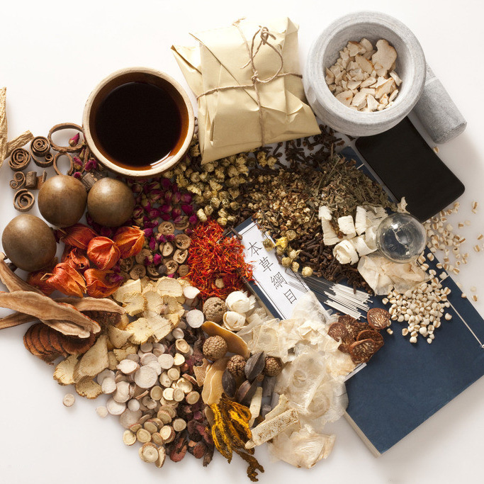
Post- reading
Thinking and discussing
1. What kind of person makes great discoveries?
2. Which is more important for making a great discovery，talent or effort?
3. Which is more important, Chinese medicine or western medicine?

Slide 18
Post- reading
Show time
1.What kind of person makes great discoveries?
Most great discoverers are brilliant and hard-working. Many are perfectionists who are unwilling to accept anything but the best.

Slide 19
Post- reading
Show time
2. Which is more important for making a great discovery, talent or effort?
I think both talent and effort are important for making discoveries. If a person doesn't have some talent it is possible that even though he or she works hard. It will be difficult to succeed. On the other hand, people-even those with great talent--rarely achieve anything without putting in efforts.

Slide 20
Post- reading
Show time
3.why could Tu Youyou achieve great success?
Possible vocabulary:
Knowledgeable; committed ; patient；determined；perseverant；hard-working；scientific spirits；modest；unselfish

Slide 21
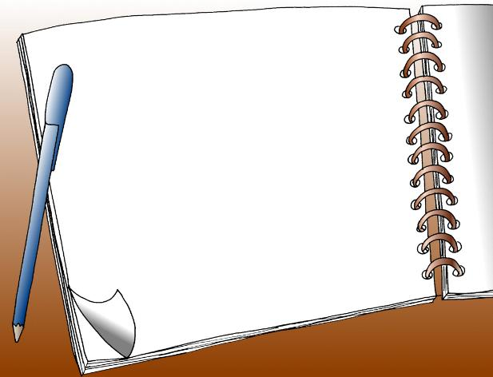
homework
Look up more information about women of great achievements on the Internet and find more information about Tu Youyou.

Slide 22
核心素养专练
你校正在组织英语作文比赛。请以身边值得尊敬和爱戴的人为题，写一篇短文参赛，内容包括：1. 人物简介；2. 尊敬和爱戴的原因。（2020全国卷I）

Slide 23
The person I respect
We have a lot of respectable people around us. They may be our teachers, parents or one of our elders. As for me, my father is the person I respect most. My father is a teacher who loves his work and his students very much. He works very hard every day but he also spares some time to accompany me and share many funny things with me about his work.
When I come across problems in my study, my father will listen to me patiently and encourage me to overcome the difficulties bravely. He achieved a lot in his work and respected by his students. Therefore, in my mind my father is the person I respect most and I love him deeply.

Slide 24
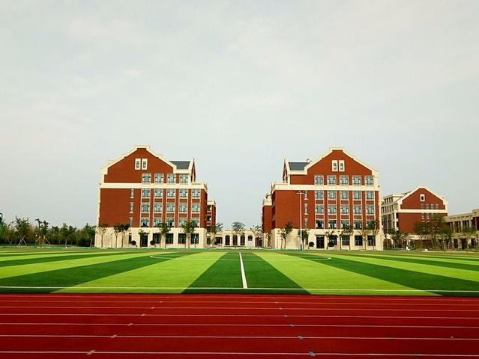
Thank you !
Have a nice day!

