Slide 1
Unit 4 Body Language Using Language Listening and Speaking

Slide 2
Teaching objectives:
By the end of this period, you will be able to
1. learn about body language and know the situations where body language is used;
2. use body language to express themselves;
3. identify the inferred meaning of the speaker in conversations.

Slide 3
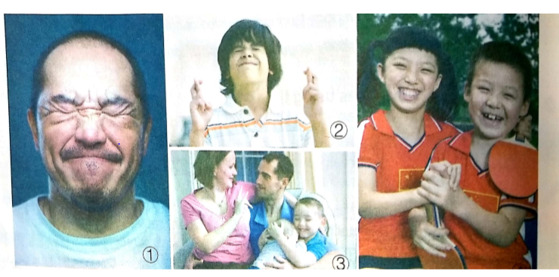
Lead-in
Look at these pictures and tell what they are communicating.

Slide 4
1. The man frowns and have tightly-shut eyes, which shows that he may be in great pain.
2. The boy crossed his fingers. Maybe he is hoping for good luck.
3. The woman in the photo is either deaf or communicating with her husband who is deaf. Her sign means “I love you.”
4. The two children seem quite happy. Perhaps they have just won a table tennis match.

Slide 5
First listening
Listen to the conversation and find out the main idea.
The two people have a pleasant conversation. They talk about their experiences of learning body language.

Slide 6
Second Listening
Activity1 Listening for details
Listen to the conversation about body language. Then answer the following questions.
How did the man get the idea of using gestures to communicate?
__________________________________________________________________________
What did the police leader tell his team by using gestures?
__________________________________________________________________________
What did the woman say about the acting classes that she has been taking?
__________________________________________________________________________

Slide 7
From an action movie.
He used gestures to tell them how many bad guys were in the house. Then he gave instructions on who should go where, and what they should do.
She said that right now they are learning how to use language to express themselves.

Slide 8
Activity 2: Listening for language
Listen again and fill in the blank with what you hear.
Woman: What were you doing just now? _______1_______
Man: Oh, I was just telling my friend over there to meet me for lunch down the street in twenty minutes.
Woman: Oh, I get it, so _______2_______
Man: Yeah, we got the idea from an action movie last night and decided to try it out for fun. In the movie, the police were trying to enter a house, but they had to be really quiet so they could take the criminals by surprise. So________3_________. For example, he used his gesture to tell them how many bad guys were in the house. Then he gave instructions on who should go there and what they should do. I thought it was pretty cool how they used hand gestures to communicate.
Woman: Well, you know, ________4__________I have been taking acting classes, and right now we are learning how to use body language to express ourselves.
Man: Wow, that’s cool. So_______5________, right?
Woman: Yes, and it’s really difficult if they want you to express something complicated without saying a word. But I am slowly getting better at it, I guess.

Slide 9
What did those gestures mean?
you were sending him secret hand signals.
the police leader used hand gestures to tell his team what to do
you can say a lot without speaking.
you mean you are not allowed to talk

Slide 10
Activity 3 Listening for inferred meaning
Listen to the conversation again. Are the following statements correct inferences from the conversation?
The two speakers are married.
Making too many gestures in communication is not polite.
The police team were probably successful in catching the criminals.
Both speakers think body language is useful.
The woman is not very confident about her silent acting ability.
No 2. No 3. Yes 4. Yes 5. Yes

Slide 11
Practice
Act out a scene using only body language to communicate. You may follow these steps to complete your performance.
Form into groups of four. One of you is the performer and the others are observers.
The performer writes down a situation and some messages to convey through body language.
The performer acts out the scene and the observers individually write down their thoughts without talking to anyone else.
The actor reveals the situation and messages and the group compares notes. Use the table below to clarify any misunderstandings or different answers.

Slide 12
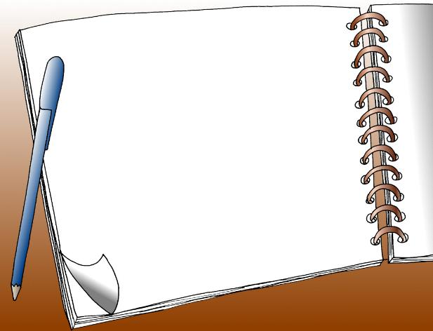
核心素养专练
Write a short summary to show your understanding of body language.

Slide 13
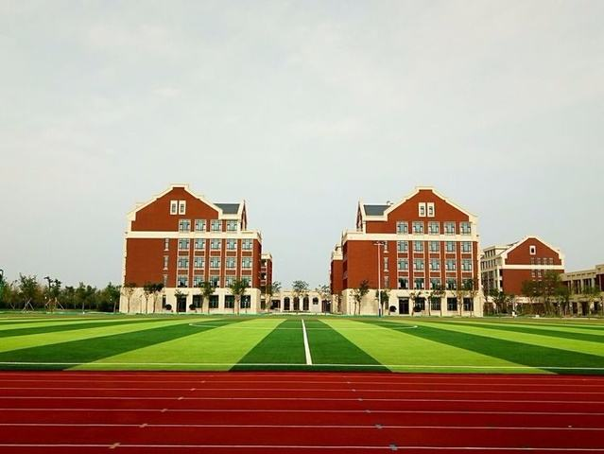
Thank you !
Have a nice day!

