Slide 1
Unit 3 Fascinating Parks Reading and Thinking

Slide 2
Teaching objectives:
1. Read the passage as a whole and summarize the main idea.
2. Experience a national park and use your senses to describe its beauty.
3. Enhance the sense of patriotism and community with a shared future for mankind

Slide 3
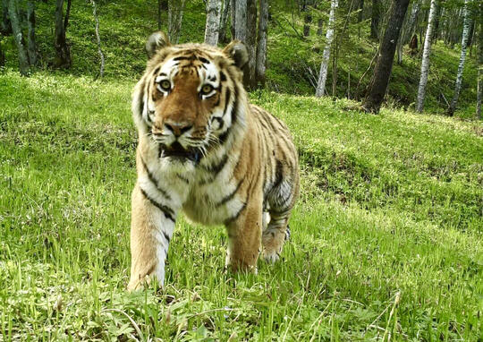
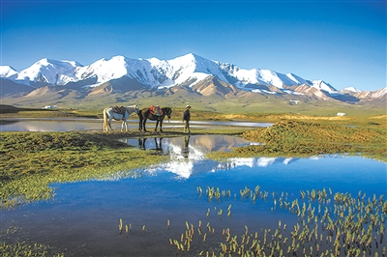
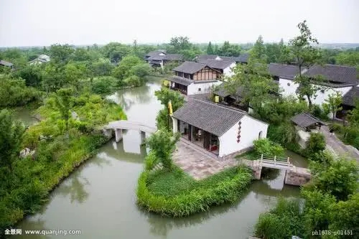
Warming up
When you think of national parks, what comes to mind first?
Beautiful scenery, wild plants, animals and so on.
The Northeast Tiger and Leopard National Park
Three River Source National Park
Xixi National Wetland Park

Slide 4
Reading for main ideas
1. Skim the text. Match the subheadings with the paragraphs.
Paragraph 1 A Land of Mountains and Ice
Paragraph 2 Man at Peace with Nature
Paragraph 3 A Land of Adventure
Paragraph 4 A Summer Where the Sun Never Sleeps
2. Summarize the main idea of the whole passage.
The travel journal mainly tells us the beauty of Sarek National Park through the author’s amazing experiences in the park.

Slide 5
Reading for details —— Facts
1. How many hours a day does the sun shine in summer in Sarek?
24 hours a day
2. What steps has the Swedish government take to keep Sarek in its natural state?
It was made a national park. No one besides the Sami can live there, and new development is banned within park boundaries.
3. How has life changed for the Sami? Why might so few Sami want to live in Sarek?
They no longer herd reindeers---- they live modern lives in cities. They might not want to live in Sarek because life conditions there are quite tough and inconvenient.

Slide 6
Reading for details —— Feelings
senses | The sentences in the text | Feelings
sight
touch
smell
taste
sound
Spreading out before me, branches of the Rapa River flow through the valley below.
At the far side of the valley, an ancient Sami cottage is visible.
Close by, there are a few reindeer feeding on grass.
After breakfast, I pack my bag and set out again. Since I must carry all of my food and supplies with me, my bag weighs about 30 kilograms.
Surprised, Amazed,
Fascinated,
Tired,
Comfortable,
Enjoyable,
Relaxed,
Satisfied,
Grateful
Here I am, alone under this broad sky, breathing the fresh air, and enjoying this great adventure.
For example, this morning my breakfast is flat bread warmed over a fire, dried reindeer meat, and some sweet and sour berries that I found growing near my tent.
I wake up to the sound of the wind buffeting the cloth of my tent.

Slide 7
Thinking
1. How do you understand the subheading?
2.Would you like to visit Sarek? Why or why not?
3.Is it worth making a place like Sarek a national park? Give your reasons.
1.①remote places inaccessible to human beings
②original & well- preserved
③a bless, a gift of nature
2. I would love to visit there, because it looks wild and wonderful.

Slide 8
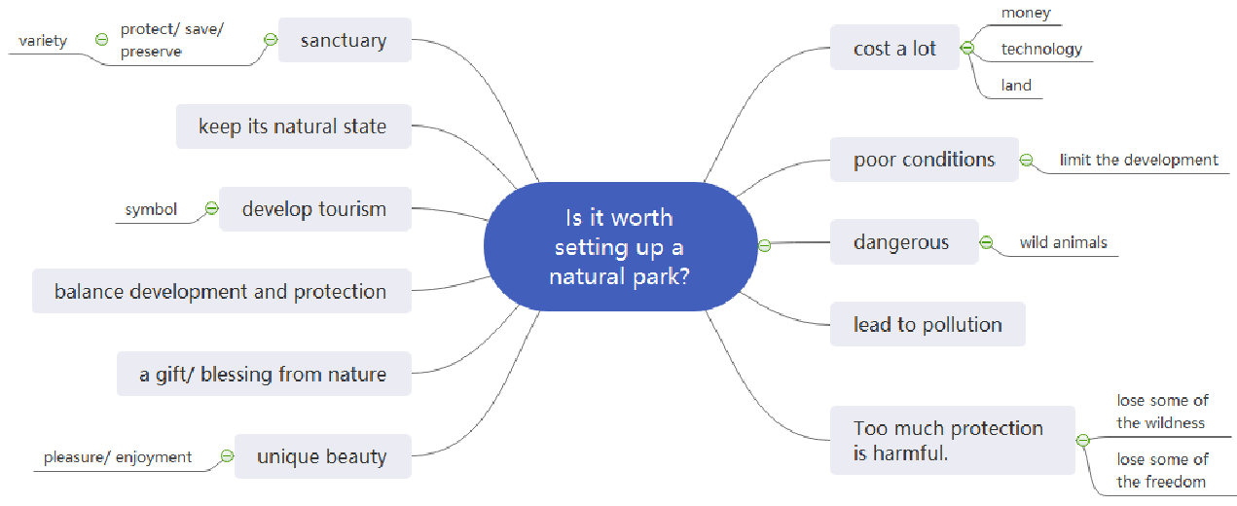

Slide 9
Focus on the Language Points
1. wake up 2. buffet the cloth 3. the mountain edge
4. flow through the valley below
5. in the remote far north
6. be covered by vast sheets of ice
7. leave behind
8. make this territory their home
9. apart from
10. keep the land in its natural state
11. new development is banned within park boundaries
12. an ancient cottage
13. close by
14. there are reindeer feeding on grass
15. pick up tents and accompany them
16. adopt their habits 17. warm bread over a fire
18. set out 19. be full of sweat
20. feel blessed to be alive 21. breath the fresh air
1.睡醒 2.敲打篷布 3.山的边缘
4.从谷底流过
5.在遥远的北方
6.被大片冰层覆盖
7.留下
8.在这片领域安家
9.除了
10.让这片土地保持自然状态
11.新的开发项目禁止在公园范围内进行
12.一个传统的小木屋
13.附近
14.有驯鹿在吃草
15.收起帐篷，跟随驯鹿
16.采用他们的习惯 17.在火上烤面包
18.出发 19.满身汗
20.感觉活着很美好 21.呼吸新鲜空气

Slide 10
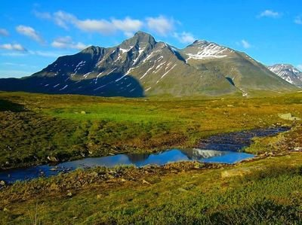
Thank you !
Have a nice day!

