Slide 1
Unit 5 Working the Land Reading and Thinking

Slide 2
Teaching objectives:
By the end of this period, you will be able to…
(1)know the story about Yuan Longping and summarize the characteristics of him.
(2)know the characteristics of language in the text.
(3)express their ideas on the given topics through critical thinking.

Slide 3
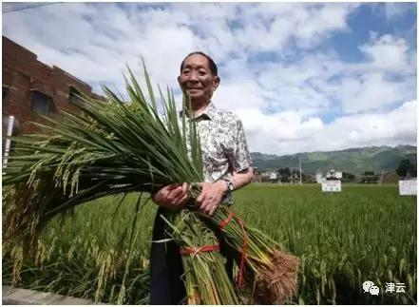
1.Who is the man in the photo? What crop is he holding in his hands?
2.What do you know about the man? What else do you want to know about him?
1.The photo is of Yuan Longping, holding sheaves of his hybrid rice.
2.I know that he is often called the “father of hybrid rice”, and his work has sparked a farming revolution in China. I suggest I want to know what he thinks about the future of China’s agriculture.

Slide 4
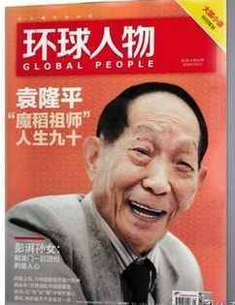
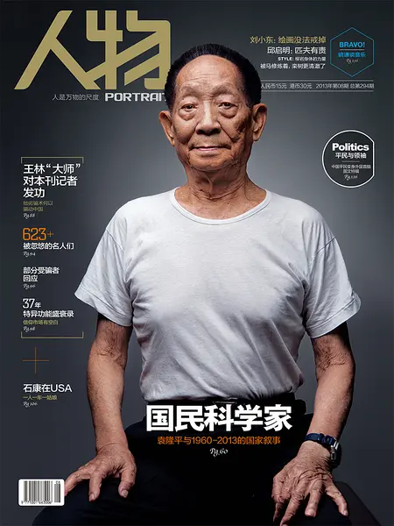
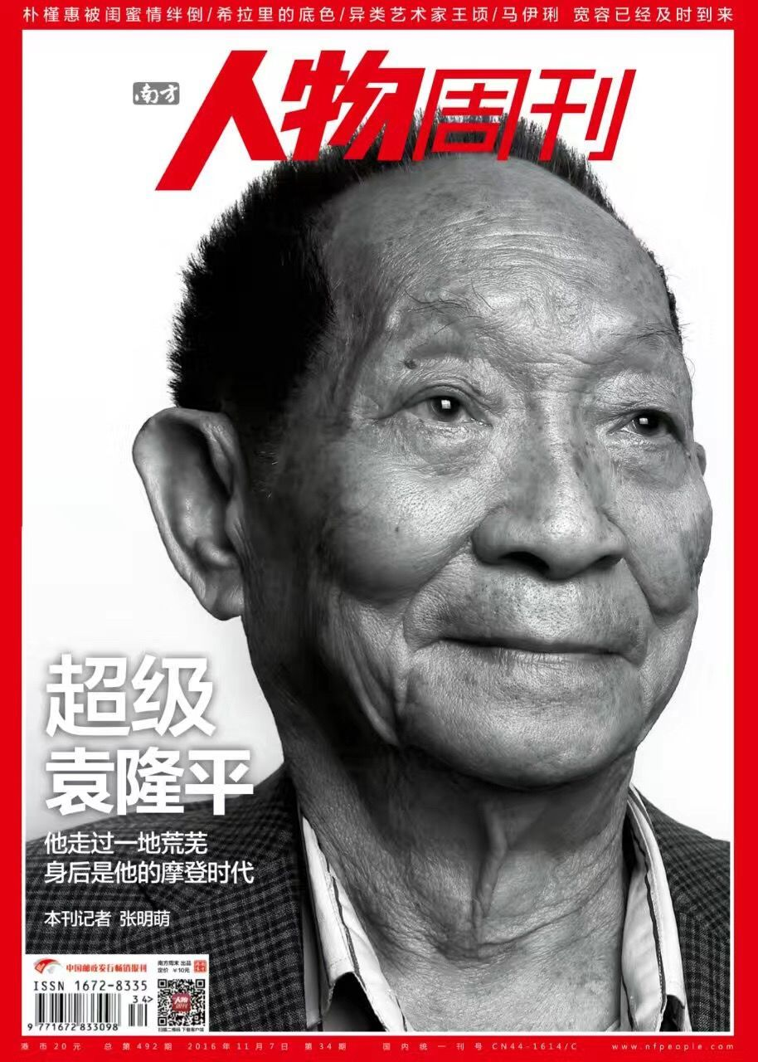
Fast Reading
Task1 Read the title and the first sentence of each paragraph. What kind of writing do you think this is? Where can you find such a piece of writing?

Slide 5
Task 2 Read the text. Match the main idea with each paragraph.
Para.1 A. Yuan conducted research and developed hybrid rice.
Para.2 B. Yuam is old but still woking hard to fulfil his dreams.
Para.3 C. Yuan considers himself a farmer.
Para.4 D. Yuan decided to study agriculture.
Para.5 E. Yuan’s innovation has helped to feed more people.
Para.6 F. Yuan cares little for fame or wealth.

Slide 6
Detailed Reading
Task 1 Read the text again and answer the questions.
1.Why does Yuan Longping consider himself a farmer?
2.Why did Yuan decide to study agriculture?
3.What is the main advantage of hybrid crops?
Because he continually works the land in his research.
He was considered that farmers had poor harvests and sometimes even had a shortage of food to eat.
One characteristic of hybrids is that they usually attain a higher yield than conventional crops.

Slide 7
Detailed Reading
4.How has Yuan’s work helped China and other countries?
5.What attitude does Yuan hold toward money or fame? What does he do?
6.What is Yuan’s latest vision?
Yuan’s innovation has helped feed not just China, but many other countries that depend on rice as well, such as India and Vietnam.
He cares little for celebrity or money.Instead, he makes large donations to support agricultural research.
Seawater rice.

Slide 8
Step IV Text Type Analysis
1. Since we have learned something about Lin Qiaozhi and Tu Youyou, do you still remember the main ideas of the two passages?
2. Can you tell me what should be included when we are introducing a person to others? And what are included in this passage?
3. In the text, the writing technique of contrast is used for many times. Can you find out them?
Lin Qiaozhi overcame a lot of difficulty and sacrificed a lot to become the “mother of ten thousand babies” while Tu Youyou and her team did a lot of research to obtain artemisinin .
Birth, education, achievements, awards, deeds, evaluation, characteristics and so on. In this passage, education about Yuan, his education, his efforts, his achievements, his characteristics are all mentioned.
Para.1 father of hybrid rice vs farmer; para.2 his parents’ wish vs his own decision para.3 the general assumption about hybrid rice vs his belief para.5 retire to a life of leisure vs continue to work the land as a man of the soil.

Slide 9
Summary
After reading the passage, what do you think of Yuan Longping? Think about some adjectives to describe him.
...
Yuan Longping

Slide 10
...
generous
modest
Yuan Longping
devoted/committed
compassionate
determined
simple/plain
creative

Slide 11
Critical Thinking
Food is the most significant thing in the world, because everyone lives on food. Do you know what kinds of measures can we take to make sure everyone can save food well?
What the government should do?
When we get together in restaurants, what should we do?
When we witness others wasting food, it’s our duty to_________________________________________.

Slide 12
First of all, governments should call on people to save food and avoid wasting food. “Clear the plate” campaign is one of the effective measure. As for us students, we should order what we can eat. If we have ordered too much, we’d better pack and take the left-over home. Last but not the least, when we witness others wasting food, it’s our duty to warn them not to do so. At the same time, we should educate the people around us to build up the idea that wasting is a shame.

Slide 13
Language Use
Fill in the blanks to complete the passage.
Yuan Longping, born in 1930 in Beijing, chose to study agriculture to tackle food ______1______(short). After _________2________(graduate) in 1953, he worked as a researcher. Yuan was convinced that the creation of hybrid rice could solve this problem. Through intense effort, Yuan overcame enormous technical difficulties to develop the first hybrid rice in 1974, ______3_____ enabled farmers to expand their output greatly.
Today, it is estimated that about 60 percent of domestic rice consumption in China __________4_________(comprise) of crops generated from Yuan’s hybrid strains. Yuan’ s innovation has helped feed not just China, but many other countries_______5_______ (depend) on rice as well, such as India and Vietnam. Because of his invaluable contributions, Yuan Longping has received numerous awards both in China and abroad.
_____6____a man of the soil, he cares little for celebrity or money. ______7______, he makes large donations to support agricultural research.______8_____ impresses people most about Yuan Longping is his ongoing ability to fulfil his dreams. His latest vision for “seawater rice” has also become a reality, and_______9_______(potential) opened up nearly one million square kilometres of salty land in China for rice production. Despite his advanced years, Yuan Longping is still young at heart and full of vision, and everyone is waiting to see what he will dream up next.
________10_______(know) as the“father of hybrid rice”, Yuan Longping is really one of China’s most famous scientists.
shortage
graduating
which
is comprised
depending
As
Instead
What
potentially
Known

Slide 14
Homework
To surf on the Internet to find more about Yuan Longping and take notes.

Slide 15
Thank you !

