Slide 1
Unit 4 Body Language Discovering Useful Structures

Slide 2
Teaching objectives:
By the end of this period, you will be able to
1. master the usages of v-ing form serving as object and predicative;
2. identify the functions of v-ing form serving as object and predicative;
3.use v-ing form freely in communication and writing.

Slide 3
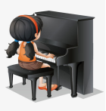
Lead in
Look at the following pictures and complete the sentences using v-ing form.
Mary enjoys_______
Mike’s job is _______
Jane practises ______
1. listening to music 2. playing the piano 3. teaching maths

Slide 4
Look and observe
Activity1. Look at the examples below, paying attention to the italicized parts. What is the function of the v-ing form? Find other examples from the reading text.
1.She enjoys learning about body language in different cultures.
2.The crucial thing is using body language in a way…
在第一个例句中v-ing形式作宾语，说明动作的承受对象。
在第二个例句中v-ing形式作表语，说明主语的内容。

Slide 5
课文中的其它例句：
1.However, you should avoid making this gesture in Brazil and Germany, as it is not considered polite.
2. Elsewhere, people favour shaking hands, bowing from the waist, or nodding the head when they meet someone else.
3. A good way of saying “ I am full” is moving your hand in circles over your stomach after a meal.
4. Perhaps the best example is smiling.

Slide 6
Activity 2. Fill in the blank with proper words and state their functions.
1.He was in low spirits and even consider _________ (go) away.
2. You should practise ________ (play) the piano every day.
3. You certainly mustn’t miss __________ (see) the wonderful film.
4. The doctor advised _________ (stay) longer in hospital.
5. Michael has delayed __________（write）to her until today.
6.Can you imagine____________ (leave) standing outside for a whole night.
7. Her job is __________(keep) the lecture hall as clean as possible.
8. One of his had habits is __________(bite) nails.
9. The maths problem is quite ___________ (puzzle).
10. They built the banks to prevent the area from ___________ (flood).
1.going 2. playing 3. seeing 4. staying 5. writing
6. being left 7. keeping 8. biting 9. puzzling 10. being flooded
动词-ing形式作宾语，跟在动词后面，表示动作的承受者；动词-ing形式作表语常表示主语的内容或者主语具有的特征。

Slide 7
常见的只跟v-ing form作宾语的动词有哪些？
只跟v-ing 形式作宾语的动词有：
admit 承认 appreciate 感激 avoid 避免 consider 考虑
delay 耽搁 resist 抵制
mention 提及 escape 避免 practice 练习 mind 介意
fancy 想不到
finish 完成 risk 冒险 suggest 建议 miss 错过
imagine 设想

Slide 8
Practice
Activity 1 Complete the passage with the correct forms of the words and phrases in the box.
Reading body language is not an easy task. It can be_______1______ because interpreting the signs that another person shows requires_______2_____. In this sense, it can be compared to a doctor__________3__________.
__________4__________ is also key to reading people’s body language accurately. For example, when ______5_____, some people avoid eye contact. By contrast, others may_____6_____ eye contact even longer than usual.
1.challenging 2. considering the whole picture 3. Evaluating a patient’s condition
4. Considering individual differences 5. lying 6. maintain

Slide 9
Activity 2. Talk about the body language you can read from the following pictures. Use at least one –ing form for each picture.
The man enjoys looking at himself in the mirror.
The woman shows her impatience by looking at her watch.
The boy is fearful, trying to run away from an angry dog.

Slide 10
核心素养专练
I 单句语法填空
People want to listen to someone who is ____________(interest), relaxed and comfortable.
(2020年新高考全国I)
Puzzle play was found to be a significant predictor of cognition after __________（control）for differences in parents’ income, education and the amount of parent talk.(2020年全国II)
Poems which had seemed dull and ___________(bore) suddenly came to life.
Do you feel like___________ (have) a talk with me after supper?
My father suggested ____________ (read) more books in my spare time.
To avoid __________ (see) by the teacher, Tom stole into the classroom by the back door.
Have you considered ____________ (build) a house in the countryside?
Some of the children are shy and they have some difficulty in _________ (make) friends.
II 翻译句子
目前形势令人担忧。
________________________________________________________________________________
2. 李明一直梦想着将来可以自己创业。
_________________________________________________________________________________
3.虽然他是一个残疾人，但在生活中总是喜欢帮助别人。
__________________________________________________________________________________

Slide 11
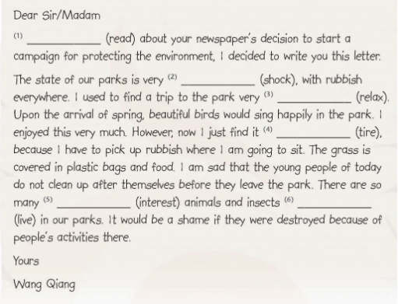
III Fill in the blank with proper words.

Slide 12
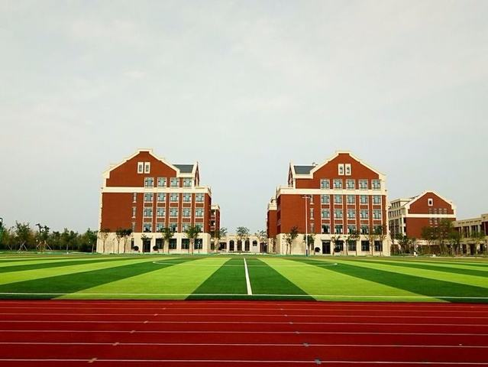
Thank you !
Have a nice day!

