Slide 1
Unit 5 Working the Land Discovering Useful Structures

Slide 2
Teaching objectives:
By the end of this period, you will be able to…
analyze the forms and features of subject clause.
learn the functions of subject clause in the context.
appreciate and use subject clause in reading and writing.

Slide 3
Lead in
What concerned Yuan Longping most while young?
What concerned Yuan Longping most while young was that farmers often had poor harvests and sometimes even had a serious shortage of food to eat.
It concerned Yuan Longping most while young that farmers often had poor harvests and sometimes even had a serious shortage of food to eat.

Slide 4
Observe and analyze
Look at the following sentences and tell the functions of the underlined sentences.
1. What concerned Yuan Longping most was that farmers often had poor harvests and sometimes even had a serious shortage of food to eat.
2. How this could be done was a challenging question of the time..
3. Whether it was possible to develop a hybrid of self-pollinating plants was a matter of great debate.
4. It is estimated that about 60% of domestic rice consumption in China is comprised of crops generated from Yuan’s hybrid strains.
5. What impresses people most about Yuan Longping is his ongoing ability to fulfil his dreams.

Slide 5
Finish the table; learn the structures and functions of the underlined sentences.
Observe and analyze
 | Structure | Function | Leading word
Sentence 1 | at the beginning of the whole sentence, beginning with “what” | act as subject
Sentence 2 |  | act as subject
Sentence 3 |  | act as subject
Sentence 4 |  | act as subject
Sentence 5 |  | act as subject

Slide 6
Finish the table; learn the structures and functions of the underlined sentences.
Observe and analyze
 | Structure | Function | Leading word
Sentence 1 | at the beginning of the whole sentence, beginning with “what” | act as subject | what
Sentence 2 |  | act as subject
Sentence 3 |  | act as subject
Sentence 4 |  | act as subject
Sentence 5 |  | act as subject
at the beginning of the whole sentence, beginning with “how”
how
at the beginning of the whole sentence, beginning with “whether”
whether
at the beginning of the whole sentence, beginning with “that”
that
at the beginning of the whole sentence, beginning with “what”
what

Slide 7
It is well known that agriculture is the foundation of our country.
It is well known that agriculture is the foundation of our country.
It is well known that agriculture is the foundation of our country.
Practice
Observe and analyze
Understand the sentence structures of following.
1. It is estimated that about 60% of domestic rice consumption in China is comprised of crops generated from Yuan’s hybrid strains.
That about 60% of domestic rice consumption in China is comprised of crops generated from Yuan’s hybrid strains is estimated.
It is estimated that about 60% of domestic rice consumption in China is comprised of crops generated from Yuan’s hybrid strains.
2. That agriculture is the foundation of our country is well known.
___________________________________________________________
It is well known that agriculture is the foundation of our country.

Slide 8
Practice
Find and mark the subject clauses in the sentences and then state their functions, leading words italicised.
1. What Yuan Longping really cared about was not money or celebrity.
2. It surprised the whole world that Yuan Longping had realised his dream of developing seawater rice.
3. How he did the experiment was puzzling to others.
4. When the sports meet will be held hasn’t been decided yet.
5. It remains a mystery where he has gone for further study.

Slide 9
Practice
1. What Yuan Longping really cared about was not money or celebrity.
2. It surprised the whole world that Yuan Longping had realised his dream of developing seawater rice.
3. How he did the experiment was puzzling to others.
4. When the sports meet will be held hasn’t been decided yet.
5. It remains a mystery where he has gone for further study.

Slide 10
Match the sentence parts, and then translate the completed sentences into Chinese.
1.______ remains an unanswered question.
2.______ is an important topic for us to research.
3.______ is that these chemicals may even cause cancer.
4. _____ these vegetables can even be planted without any soil through this new technology.
5.______ is the reason why some people prefer to live in the country rather than in the city.
A What worries many people
B That the lifestyle is slower and healthier
C How We can find a suitable solution to produce sufficient food while keeping the environment safe
D When these wheat farmers will join this pilot experiment
E It amazed all of us that

Slide 11
1 D; 这些小麦农户什么时候会加入预试验仍然不得而知。
2 C; 如何能够找到一个合适的解决办法，在保证环境安全的同时，生产足够的粮食，是一个需要我们研究的重要课题。
3 A;令很多人担心的是，这些化学制品甚至可能导致癌症。
4 E;令我们所有人惊讶的是，通过这种新技术，可以无土栽培这些蔬菜。
5 B;有些人更喜欢住在乡下而非城市的原因是前者生活节奏更慢、生活方式更健康。

Slide 12
Circle and correct the mistake in each sentence. (Workbook P90 Exercise 3)
1 What have I forgotten is that I have a test today.
2 Who left me these flowers are not clear to me.
3 This is obvious that students should prepare well for their future.
4 Who’s ticket this is has not been confirmed.
5 When the test will be given have not been decided.

Slide 13
1 What I have forgotten is that I have a test today.
2 Who left me these flowers is not clear to me.
3 It is obvious that students should prepare well for their future.
4 Whose ticket this is has not been confirmed.
5 When the test will be given has not been decided.

Slide 14
Read the passage and underline all the subject clauses. Then discuss whether the sentences with subject clauses can be paraphrased.
Grandma has been complaining about the vegetables sold in the supermarket, which have been grown using chemical fertilisers. To her, that they look beautiful on the outside is obvious. However, what she is unhappy about is the lower nutritional value and reduced flavour. Now that both of my grandparents have retired from their jobs in the city, how they are going to spend their retirement is an important decision for them. Whether they can live a healthy life is the first thing they are considering. So they have made up their minds to move to the countryside, where they can live a green life.

Slide 15
Grandma has been complaining about the vegetables sold in the supermarket, which have been grown using chemical fertilisers. To her, that they look beautiful on the outside is obvious. However, what she is unhappy about is the lower nutritional value and reduced flavour. Now that both of my grandparents have retired from their jobs in the city, how they are going to spend their retirement is an important decision for them. Whether they can live a healthy life is the first thing they are considering. So they have made up their minds to move to the countryside, where they can live a green life.
To her, it is obvious that they look beautiful on the outside.

Slide 16
Prepare a presentation
What qualities do you think make a person like Yuan Longping so successful? Have a discussion and prepare a presentation.
What impresses me most is that …
What makes him/her a great … is that …
It is important that …
Whether … depends on …
That … is his/her most important quality.
What impresses me most is that …
What makes him/her a great … is that …
It is important that …
Whether … depends on …
That … is his/her most important quality.

Slide 17
What impresses me most is that Yuan Longping has succeeded in helping to feed so many people. It is important that he never gave up, despite many difficulties. That he succeeded in realising his dream is what makes him great.

Slide 18
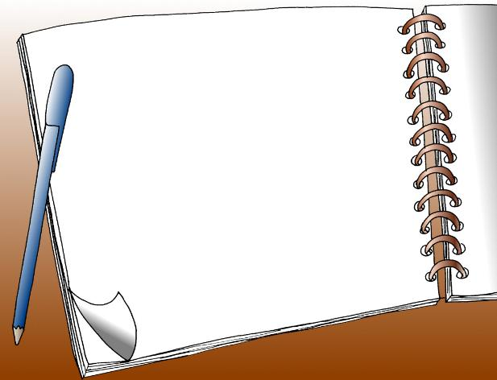
homework
Finish Activities 1、2、4 in Using Structure of Workbook on page 90.

