Slide 1
Unit 2 Looking Into The Future Reading and Thinking

Slide 2
Teaching objectives:
By the end of this period, you will be able to…
1. learn how smart homes make our life easier.
2. learn about the advantages and disadvantages of technology in the future.
3. analyze the structure of the article and summarize the main idea for each
paragraph.
4. express your opinions on smart homes.

Slide 3
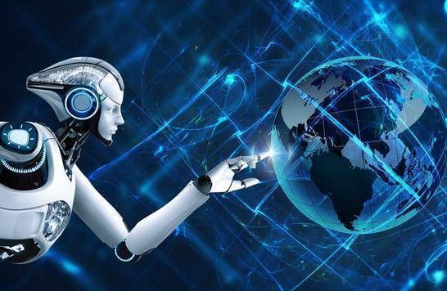
The best way to predict the
future is to create it.
—Peter Drucker

Slide 4
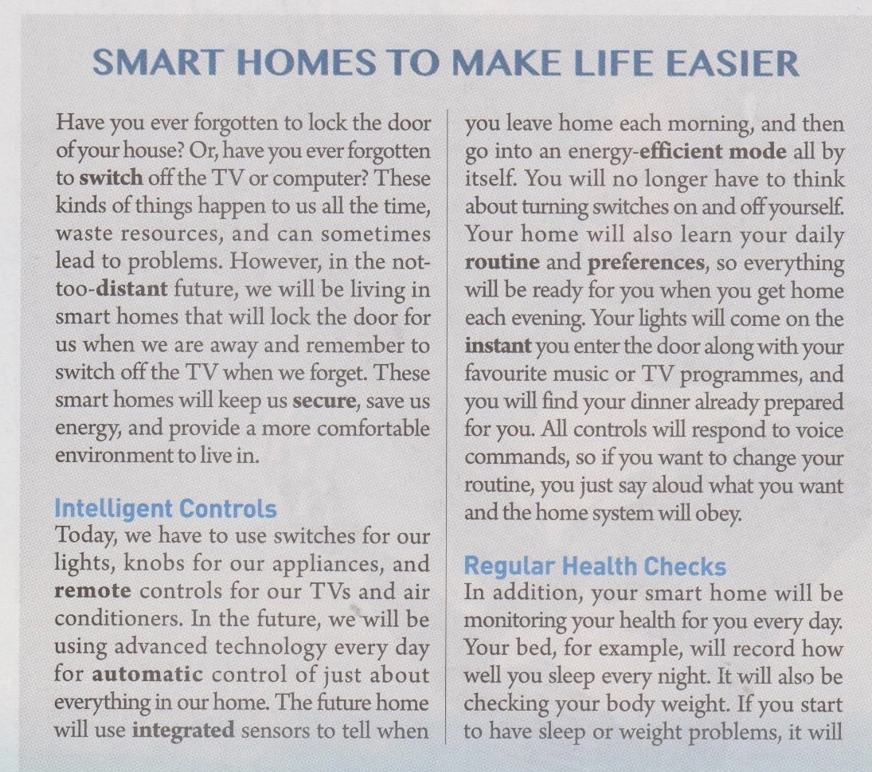
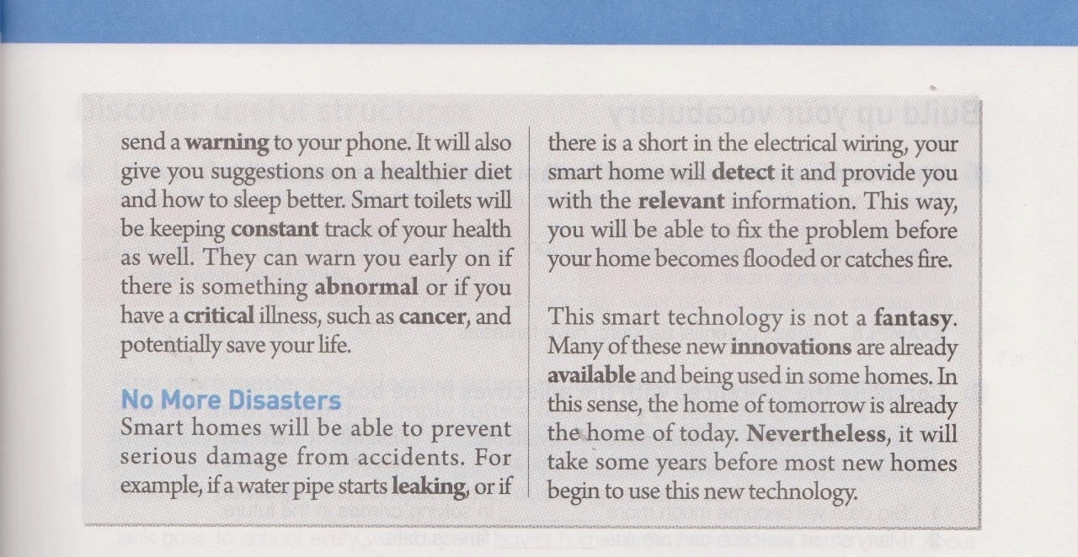
1.What does it mean when we say that something such as a phone is “smart” ?
2.What do you think a “smart” house can do that other houses cannot?
To say that something is smart means that it can make decisions on its own without a hunman telling it what to do,
and that ian also learn how to do things itself.
I would expect that a smart house could control room temperature and lights, for example.

Slide 5
Skimming for main ideas
Task 1 Read the text and find out the main idea of each paragraph.
Have you ever forgotten to lock the door of your house? Or, have you ever forgotten to switch off the TV or computers? These kinds of things happen to us all the time, waste resources, and can sometimes lead to problems.
However, in the not-too-distant future, we will be living in smart homes that will lock the door for us when we are away and remember to switch off the TV when we forget. These smart homes will keep us secure, save us energy, and provide a more comfortable environment to live in.
problems
bad results
逻辑线索：however, 表转折
main idea：Give a brief introduction to smart homes.

Slide 6
Intelligent Controls
Today, we have to use swithes for our lights, knobs for our appliances, and remote controls for our TVs and air conditioners. In the future, we will be using advanced technology every day for automatic control of just about everything in our home. The future home will use integrated sensors to tell when you leave home each morning, and then go into an energy-efficient mode all by itself. You will no longer have to think about turing switches on and off yourself. Your home will als learn your daily routine and preferences, so everything will be ready for you when you get home each evening. Your lights will come on the instant you enter the door and along with your favourite music or TV programmes, and you will find your dinner already preared for you. All contrals will respond to voice commands, so if you want to change your routine, you just sy aloud what you want and the home system will obey.
Today 时间状语
Future 递进关系
automatic control
main idea：Smart homes can make intelligent controls.
how does it work
benefits

Slide 7
Regular Health Checks
In addition, your smart home will be monitoring your health for you every day. Your bed, for example, will record how well you sleep every night. It will also be checking your body weight. If you start to have sleep or weight problems, it will send a warning to your phone. It will also give you suggestions on a healthier diet and how to sleep better. Smart toilets will be keeping constant track of your health as well. They can warn you early on if there is something abnormal or if you have a critical illness, such as cancer, and potentially save your life.
your bed (how well you sleep)
check your body weight
send a warning
give suggestions
monitor health
smart toilets (keep track of your health)
warn you
abnormal
main idea：Smart homes can check our health.

Slide 8
No More Disasters
Smart home will be able to prevent serious damage from accidents.
For example, if a water pipe starts leaking, of if there is a short in the electrical wiring, your smart home will detect it and provide you with the relevant information. This way, you will be able to fix the problem before your home becomes flooded or catched fire.
water pipe starts leaking
prevent damage
detect it and provide information
a short in the electrical
main idea：Smart homes can prevent damage from accidents.

Slide 9
This smart technology is not a fantasy. Many of these new innovations are already available and being used in some homes. In this sense, the home of tomorrow is already the home of today. Nevertheless, it will take some years before most new homes begin to use this new technology.
main idea：Smart technology is not a fantasy,but it will take some years.

Slide 10
Skimming for main ideas
Use your own words to summarize the main idea for each paragraph.
Paragraph1：Give a brief introduction to smart homes.
Paragraph2：Smart homes can make intelligent controls.
Paragraph3：Smart homes can check our health.
Paragraph4：Smart homes can prevent damage from accidents.
Paragraph5：Smart technology is not a fantasy,but it will take some years.

Slide 11
Skimming for main ideas
Smart homes: Benefits
Para1: a brief introduction of smart homes
Para2.
Intelligent controls
Para3.
Regular health checks
Para4.
No more disasters
Para5. The situation of smart home

Slide 12
Scanning for details
In the future, what will smart homes do about?
doors | lock the door for us when we are away | dinners | prepare dinner for us
TVs, computers | switch off TVs and computers when we forget | beds | record how well we sleep every night, check our body weight, send a warning to our phones when we have sleep or weight problems, and give us suggestions on a healthier diet and how to sleep beetter
water pipes, electrical wires | detect if there is a problem and provide us with the relevant information | toilets | keep constant track ou our health and warn us early on if there is something wrong
lights, favourite music, or TV programmes | come on the instant we enter the door

Slide 13
Analyze the writing techniques
1. What genre is the passage?What are its features?
It is a popular science article(科普说明文).
Features: A brief and eye-catching title;
Explaining general concepts in a simplified way;
Emphasizing on main events;
Using quotes, metaphors (比喻), analogies (类比)
to explain difficult or abstract scientific concepts.
2.How does the text develop?
It develops in chronological order.

Slide 14
Analyze the writing techniques
3.What writing techniques are used in this article?
Giving examples, using comparisons.
4.Where can you find this kind of passage?
It is presented in many forms, including books, newspaper, magazine articles, web pages, etc.

Slide 15
Discussion
Discuss the questions.Work in pairs.
1.In what way is the home of tomorrow already the home of today?
Many of the new innovations are already used in some homes today. This is true especially of automaitc controls for things such as lights and air conditioners.

Slide 16
Discussion
2.What might be some of the disadvantages of smart homes?
One disadvantage is that if there is a proplem with the system, you may find yourself locked out of the house, or unable to turn your TV off or on. Security is another big concern, as strangers may be able to hack into the system to collect information about your life and use that for evil purposes.

Slide 17
核心素养专练
课文语法填空，在空白处填入1个适当的单词。
A smart home is one that ___________computers into the structure of the building itself. In this way, many of the things that we now do ourselves will become ___________ . For example, the smart home could control the air conditioning and lights so that you would no longer have to turn _________ on and off, making your home more energy-____________ . The smart home could also __________itself to make sure that everything is working as it should, and send you _________if there is a problem. Such smart homes could even be programmed to _________your health problems, and then give you_________ advice as to the food you should eat or if you should see a doctor. So, in a sense, smart homes will lead us to living smarter lives.
integrates
automatic
switches
efficient
monitor
warnings
detect
relevant

Slide 18
Thank you !

