Slide 1
Unit 4 Body Language
Period 5 Build up your vocabulary

Slide 2
Teaching objectives:
By the end of this period, you will be able to…
1. further understand the usages of such important words and expressions as interaction, vary, approve, witness, employ, favour, break down, reliable, in other words, tendency, occupy, distinguish, anxiety ,etc; learn to express themselves by using them.
2. learn to use the right collocation between adjectives and the nouns, verbs and their objects.
3. use what they have learned into writing.

Slide 3
Revision
Fast translation
使用肢体语言时，最重要的是要符合你所处的文化。
______________________________________________________________________
2.在巴西和德国，你应该避免使用OK这个手势，因为这是一个被视为不礼貌的手势。
______________________________________________________________________
3.微笑可以帮助我们摆脱困境，在陌生的世界里找到朋友。
______________________________________________________________________
The crucial thing is using body language in a way that is appropriate to the culture you are in.
In Brazil and Germany, you should avoid using the gesture for “OK”, as it is not considered polite.
A smile can help us get through difficult situations and find friends in a world of strangers.

Slide 4
interaction n. 交流；相互影响
【教材回扣】We use both words and body language to express our thoughts and opinions in our interactions with other people.
【同义句替换】
We communicate with others by using words and body language.
【语境感知】
Mark Twain is well known for his witty remarks in his everyday interactions with people.(新外研选择性必修一)
I like the comedy because of the way they interact with one another.(新北师选择性必修二)
I believe the Internet has made media more interactive.(新北师选择性必修二)
After the speech was over, we can have interactions with Professor Smith.

Slide 5
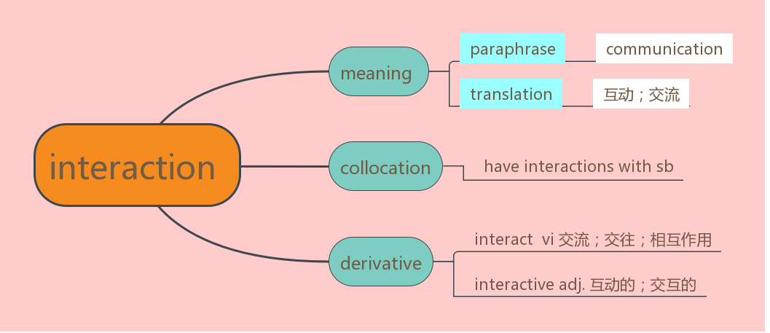
【用法小结】

Slide 6
【考点运用】
翻译句子
在课堂上，老师应该多创造机会和孩子们互动。
_________________________________________________________________________
2. 玛丽和班上其他的孩子们相处得很好。
________________________________________________________________________
(1) In class, the teacher should create opportunities to interact with students.
(2) Mary interacted with other children very well in class.
【例句仿写】
我们有时候用眼神和别人交流。
____________________________________________________________________
Sometimes we have interactions with others by using eye contact.

Slide 7
2.vary vi. 变化；改变
【教材回扣】Just like spoken language, body language varies from culture to culture.
不同的文化有着不同的肢体语言，这与口头语言相似。
【同义句替换】
Body language is cultural-specific and so is spoken language.
【语境感知】
Changes in price normally vary with the changes of supply and need.
Though Mary and Jane are twins, they vary in character.
A variety of books are available in the bookshop of our city.
I also shop for various things online, such as books, computer hardware and other necessities.(新北师必修一)
In the UK and the US, senior high school students take part in various after-school activities, such as club activities and volunteer work.(新外研必修一)

Slide 8
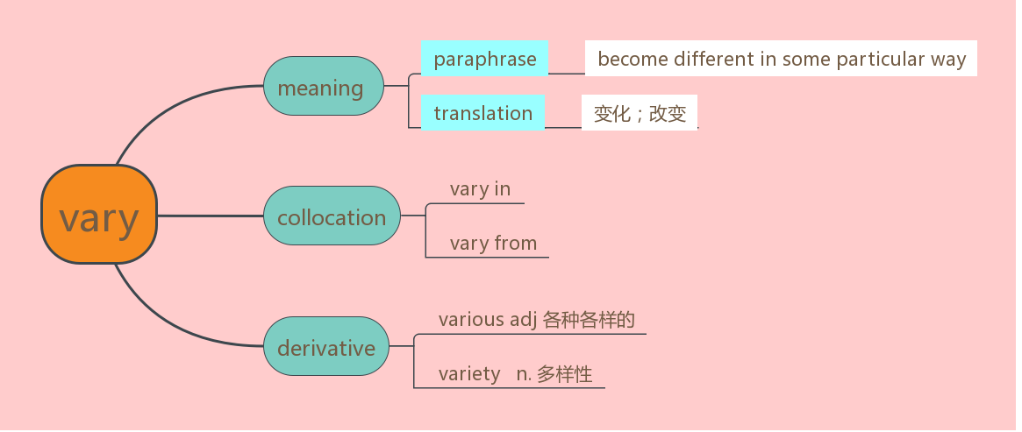
【用法小结】

Slide 9
【考点运用】
单句语法填空
①For__________(vary) reasons, he didn’t turn up at our English evening party last night.
②The goods in the supermarket vary ________ size, color as well as price.
③More than 750,000 have graduated from SAC, with many seeking employment in engineering, aviation, education,medicine and a wide (various) of other professions.(2018北京,阅读理解B)
④ The variety of the books in the library of Beijing University ___________(be) astonishing.
Suggested answers:
①various ② in ③ variety ④ is

Slide 10
【例句仿写】
手势“OK”在不同的文化中意思各不相同。
The gesture for “OK” varies in different cultures.
3. approve vi赞成；同意 vt.批准；通过
【教材回扣】In other countries, by contrast, eye contact is not always approved of.
相反，在另一些国家，眼神交流并不总是认可。
【同义句替换】
By comparison, it is not considered appropriate to make eye contact in other countries.

Slide 11
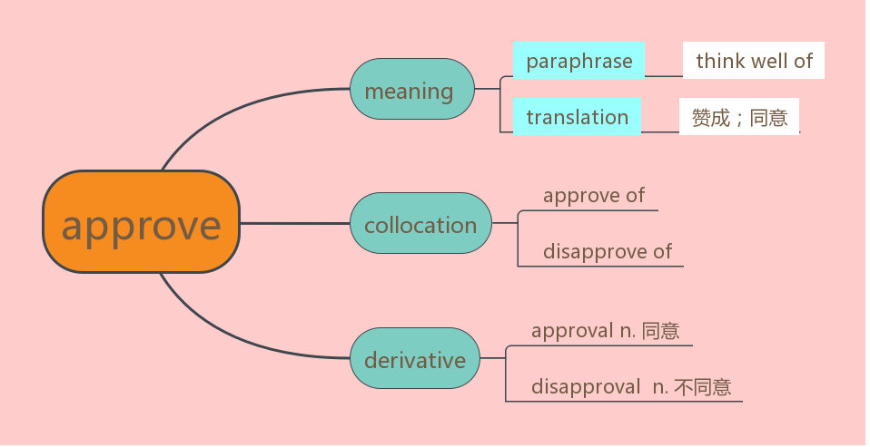
【语境感知】
I approve of your trying to earn some money, but please don't ignore your studies. She desperately wanted to win her father's approval.
At first, people approved of Galilei ’ studies and urged him to continue, but later when he proved Aristotle wrong, they grew angry and put him in prison.(新北师选择性必修二)
【用法小结】

Slide 12
【考点运用】
单句语法填空
She doesn’t approve_______ our decision, which makes us upset.
I hope that these arrangements will meet with your __________(approve).
(1) of （2）approval
【例句仿写】
相比之下，在巴西和德国， 使用OK手势是不被认可的。
By comparison, using the gesture for “OK” is not approved of in Brazil and Germany.

Slide 13
4.witness vt.当场看到；目击 n. 目击者；证人
【教材回扣】In Japan, someone who witnesses another person employing the gesture might think it means money.
在日本，一个人看到另外一个人使用这个手势，可能会认为这表示金钱。
【同义句替换】
In Japan, when one person sees another person using the gesture, he or she is likely to think it refers to money.
【语境感知】
These art works bear witness to the creativeness of the Chinese people.
You didn’t witness the wonders I beheld.
Some sites are bringing the news directly from the people who are experiencing or witnessing it, on the spot of a car accident for example. (新北师选择性必修二)

Slide 14
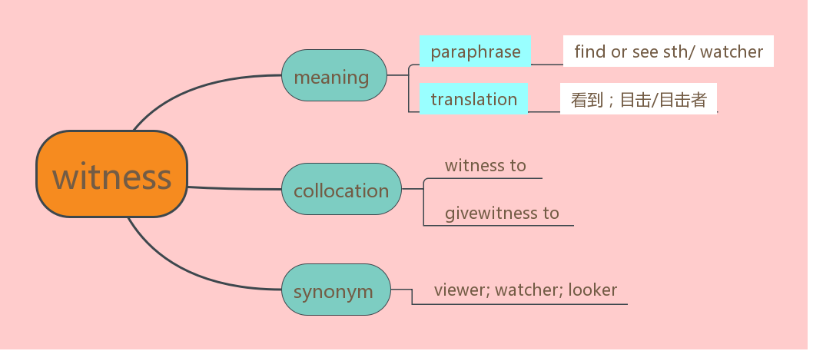
【用法小结】

Slide 15
【考点运用】
单句语法填空
①The driver witnessed to ________ (see) the man enter the building.
② However, her children have learned an important lesson _________ (witness) their mother earn her degree. (2020新高考全国I,阅读理解B)
①seeing ② witnessing
翻译句子
她的健康是治疗成功的见证。
______________________________________________________________
His good health is a witness to the success of the treatment.
【例句仿写】
在法国，一个人看到另一个人用“OK”这个手势，她或他会认为这表示“零”。
In France, when one person witnesses another person using the gesture for “OK”, he
will think it means zero.

Slide 16
5.employ vt.使用；应用；雇用
【教材回扣】In Japan, someone who witnesses another person employing the gesture might think it means money.
在日本，一个人看到另外一个人使用这个手势，可能会认为这表示金钱。
【同义句替换】
___________________________________________________________________
In Japan, when one person sees another person using the gesture, he or she is likely to think it refers to money.
【语境感知】
The manager employed the girl as his assistant.
After graduation, Cathy was employed to take care of the old in the nursing home. Employed in an important meeting, he has no time to go back home.
In some companies, employees can work from home, or the park or anywhere they like. (新北师选择性必修一)
Professor Salovey, who invented the term EQ, gives the following description: at work, it is IQ that gets you employed, but it is EQ that gets you promoted.(新北师选择性必修三)

Slide 17
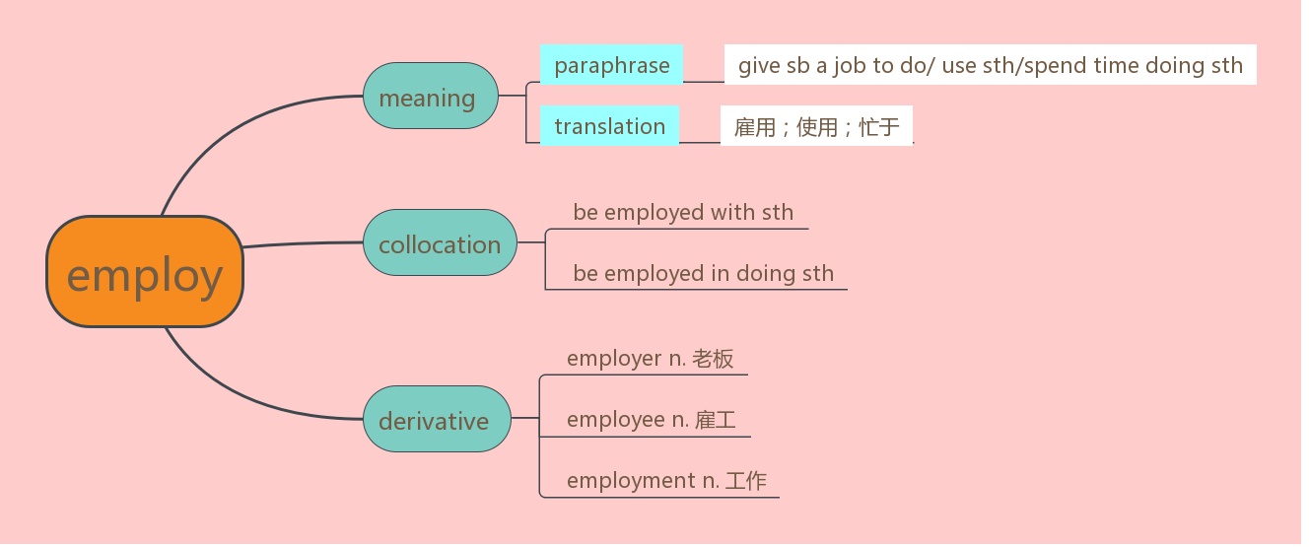
【用法小结】
【考点运用】
单句语法填空
①________ (employ) in teaching, he has no time to take care of his family, which makes his wife upset.
②The zoo wanted to employ more people _________ (keep) it running.
①Employed ② to keep

Slide 18
6.favour vt. 较喜欢；选择；有利于n. [c]帮助；恩惠［U]赞同；偏爱
【教材回扣】Elsewhere, people favor shaking hands, bowing from the waist, or nodding the head when they meet someone else.
在其他地区，与别人见面时，人们更喜欢握手、鞠躬或点头。
【同义句替换】
___________________________________________________________________
People prefer to shake hands, bow from the waist or nod the head when meeting someone else in other parts of the world.
【语境感知】
The current economy does not favour the development of small businesses.
I would never ask for any favours from her.
As a special favour, I'll let you stay up late tonight.
Can you do me a favour and find out what’s going on?(新北师必修二）
In addition to blogging, taking photos and writing articles about the reef, he made a number of appearances on television to argue in favour of its defence.(新外研选择性必修一)

Slide 19
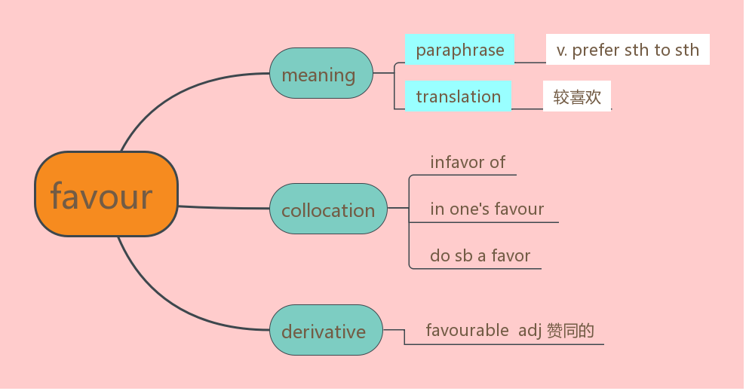
【用法小结】

Slide 20
【考点运用】
单句语法填空
①Opportunity_________(favour) those with a curious mind.(2019天津, 阅读理解D)
②Those present at the meeting were ________ favor of the decision.
① favours ② in
【例句仿写】
_____________________________________________________
在有些地方，人们喜欢见面的时候拥抱。
In some places, people favour hugging each other when they meet.
7.break down 消除；分解；打破；出故障；抛锚；失败；崩溃；垮掉
【教材回扣】A smile can break down barriers.
微笑可以打破隔阂。

Slide 21
【同义句替换】
_________________________________________________________
A smile can make the problems between people disappear.
【语境感知】
Our car broke down and we had to draw it to a garage.
His health broke down under the pressure of work.
Talks between the two sides have broken down.
When Abraham Lincoln was elected president, the southern states broke away and formed a new nation.
Scott left on 1 November and soon had problems. First, his two sledges broke down and then the horses began to have serious difficulties with the snow and the cold. (新北师必修二）

Slide 22
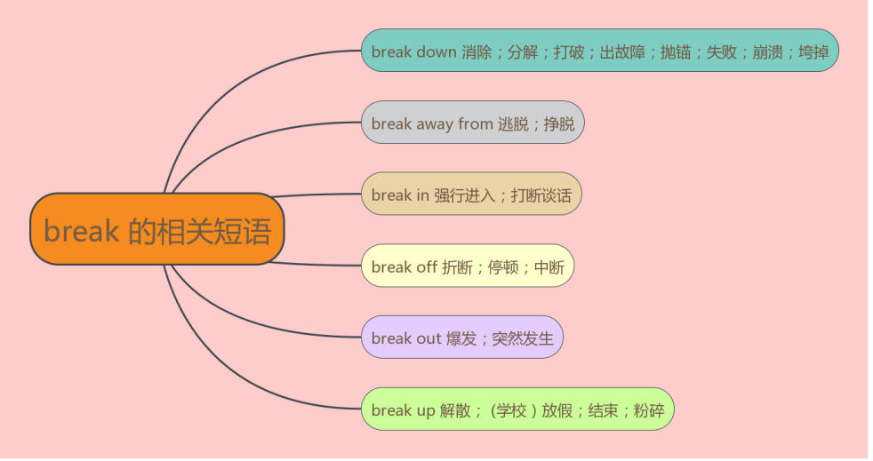
【用法小结】

Slide 23
【考点运用】
用适当的介词或副词填空。
Her friends came to help her when the war broke ________.
Burglars broke _________ the house when the owner was away on holiday.
（1）out (2)into
8. reliable adj. 可靠的；可信赖的
【教材回扣】Which is a more reliable guide for understanding someone’s feelings, their body language or the words they speak?
哪一种方式更能帮助我们理解别人的感受：是肢体语言还是他们说的语言？
【同义句替换】
_______________________________________________________________________
Which way of communication can help us to understand someone’s feelings better, their body language or their words?

Slide 24
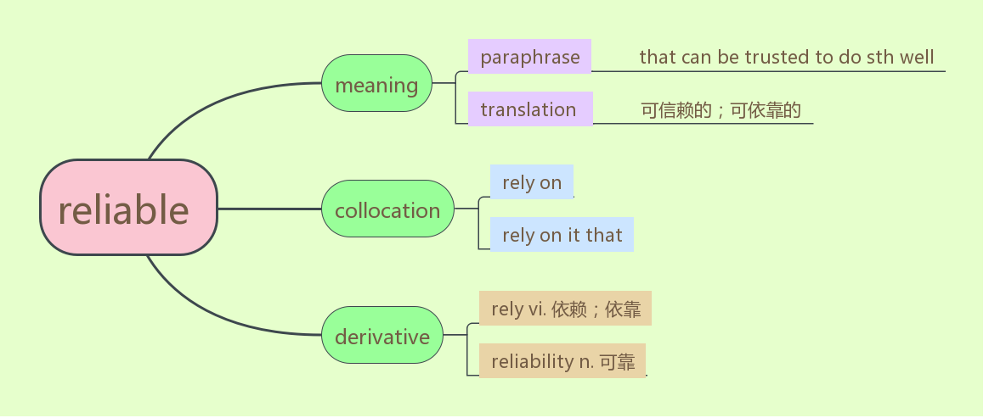
【语境感知】
Tom is clever while Jack is honest and reliable.
Learn to rely on yourself first, then others.
We have to rely on him to make the design.
You can rely on it that he will help you.
For accurate and reliable predictions, it’s best to check an official, scientific report..(新外研选择性必修三)
【用法小结】

Slide 25
【考点运用】
单句语法填空
The young man is honest, cooperative and always there when you need his help. In short, he is _________(rely).
These days, we rely heavily ______ computers to organize our work.
（1）reliable（2）on
【例句仿写】
______________________________________________________________
日本人见面的时候更喜欢用哪一种方式表示问候？鞠躬还是亲吻脸颊？
Which way do Japanese prefer to use to show their greetings when they meet,
bowing or kissing on the cheek?

Slide 26
tendency n. 趋势；倾向；趋向；偏好
【教材回扣】People have a tendency to lean towards whatever they are interested in.
人们在对某个事物感兴趣时，往往会身体前倾。
【同义句替换】
People are more likely to lean towards something when they show interest in it.
【语境感知】
While I tend to buy a lot of books, these three were given to me as gifts.
(2020全国II，阅读理解B)
People tend to get together with their families in the week-long holiday.
He has a tendency to forget things.
On social media sites, people tend to post only positive updates that make them appear happy and friendly. (新外研必修一)

Slide 27
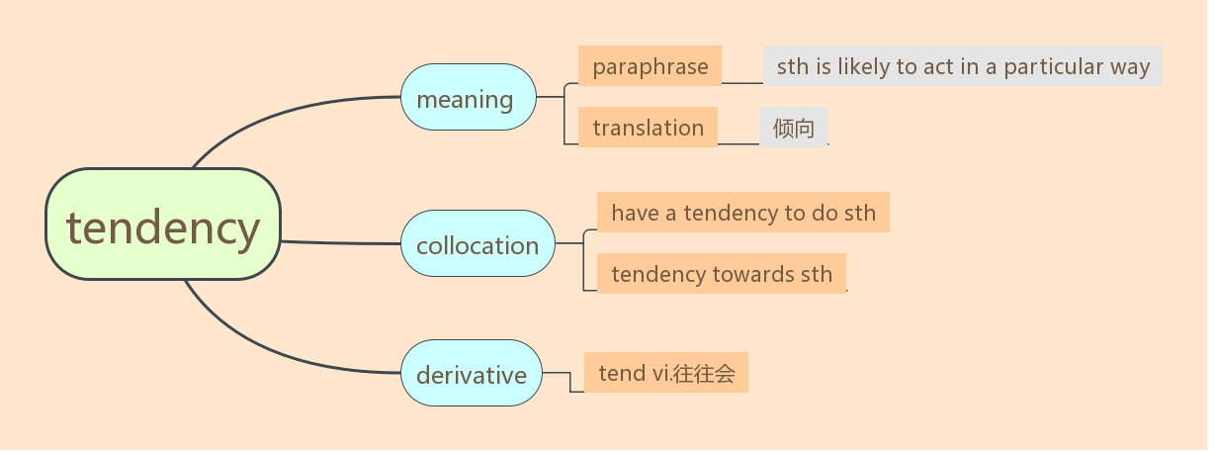
【用法小结】

Slide 28
【考点运用】
单句语法填空
When I am tired, I tend _________(make) mistakes.
Wool has a __________(tend) to shrink if it gets wet.
making（2）tendency
【例句仿写】
________________________________________________
当学生在课堂上感到无聊时，他往往会东张西望。
When a student feels bored in class, he or she will look around.

Slide 29
10.occupy vt. 占据（空间）； 占用（时间）； 居住；占领
【教材回扣】With their chins on their hands, they occupy themselves by staring out of the window or up at the ceiling.
他们托着下巴，全神贯注地盯着窗外或天花板。
【同义句替换】
_________________________________________________________________
Their chins resting on their hands, they engaged themselves in looking out of the window attentively or up at the ceiling.
【语境感知】
Reading occupies most of my free time.
The enemy soon occupied the town.
She occupied herself with routine office tasks.
I know you have had lots to occupy your time, so you probably didn’t have time to watch the football match between Manchester United and Liverpool tonight. (新北师必修一)

Slide 30
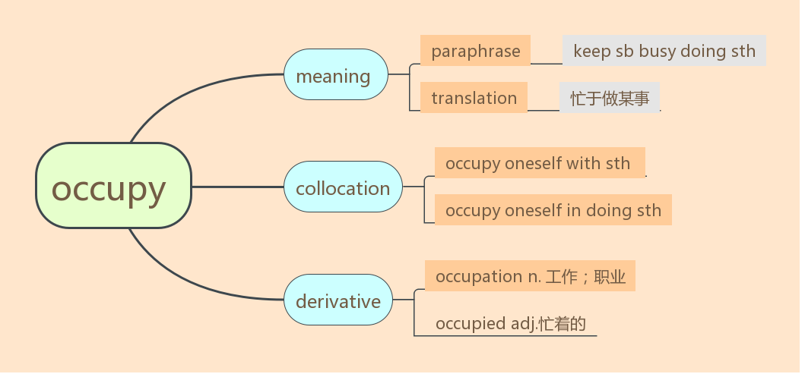
【用法小结】
【近义短语】
Be engaged in doing sth
Be busy in doing sth
Be buried in doing sth

Slide 31
【考点运用】
单句语法填空
They have been _________(occupy) in preparing for their 50th wedding anniversary in the past two weeks.
Please list your age, name and ____________(occupy) on the application form.
Many of us equate “commitment” with such “caring”_______________(occupy) as teaching and nursing. (2019年天津)
occupied（2）occupation (3)occupations
【例句仿写】
___________________________________________________________
脸上一副茫然的表情，有些同学在全神贯注地想入非非。
With blank expressions on their face, some students are occupied in letting their minds wandering.

Slide 32
11.stare vi. 盯着看；凝视
【教材回扣】With their chins on their hands, they occupy themselves by staring out of the window or up at the ceiling.
他们托着下巴，全神贯注地盯着窗外或天花板。
【同义句替换】
_____________________________________________________________
Their chins resting on their hands, they engaged themselves in looking out of the window attentively or up at the ceiling.
【语境感知】
Generally, it's considered rude to stare at people.
She gave him a blank stare.
With water falling off its thick, brown hair, the bear stared back at me.(新外研必修一)

Slide 33
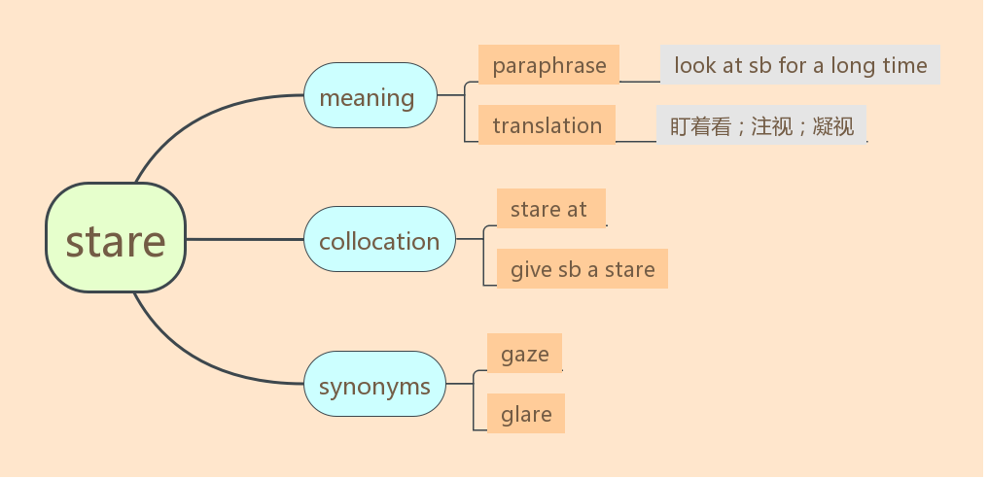
【近义短语】
stare at. . . 盯着…看
stare n.凝视
glare at sb 怒目而视
【用法小结】

Slide 34
【考点运用】
完成句子
I _________ the door and wondered why she didn’t appear.
我盯着门口看，想知道他为什么没有出现。
He didn’t shout; he just ___________ me silently.
他没有喊叫，只是默默地怒视着我。
（1）stared at（2）glared at

Slide 35
12.distinguish v. 区分；辨别；分清
【教材回扣】While it is easy to perceive when students are interested, bored, or distracted, it
is sometimes much harder to distinguish when students are troubled.
尽管学生们何时对讲课感兴趣，何时感到无聊或精力不集中是容易察觉的，但要发现学生何时有困扰有时会难得多。
【同义句替换】
__________________________________________________________________
Although it is not difficult to realize when students show interest, feel dull or fail to concentrate on study, it is a tough task to tell when students meet with trouble.
【语境感知】
Sometimes reality and fantasy are hard to distinguish.
Over the next few years he distinguished himself as a leading constitutional scholar.
The solar rays shone through the watery mass easily, and consumed all colour, and I clearly distinguished objects at a distance of a hundred and fifty yards. (新外研必修三)

Slide 36
【用法小结】

Slide 37
【考点运用】
完成句子
（1）The man___________ for a major breakthrough in the treatment of cancer.
这个人因其在治疗癌症方面有了重大突破而扬名。
(2)True adults are able to _________ what they have to do and what they want to do.
真正的成年人能辨别出什么是该做的事和什么是想做的事。
（1）distinguished himself（2）distinguish between
【例句仿写】
尽管老师从学生的面部表情可以了解他们在课堂上的感受，但是洞察他们的想法还是有点难度。
____________________________________________________________________
While teachers can be aware of how students feel in class by observing their expressions on their faces, it is still a little tough to perceive what they think.

Slide 38
13. anxiety n. 焦虑；担心；害怕；不安；渴望
【教材回扣】
Students who are angry, afraid, or experiencing anxiety may have their arms crossed in front of their chests and their legs closed or crossed, like they are guarding their bodies.
愤怒、害怕或焦虑的学生会双臂交叉放在胸前，双腿并拢或交叉，像是在保护自己的身体。
【同义句替换】
When students feel annoyed, frightened or anxious, they are likely to cross their arms in front of their chests and their legs closed or crossed. It looks as if they are defending themselves.

Slide 39
【语境感知】
There is growing public anxiety over levels of air pollution in our cities.
Jack still can't help being anxious about his job interview.
The farmers are more anxious for rain than the people in the city because it is more important to them.
Scott and Amundsen waited anxiously for spring.(新北师必修二)
Research shows that laughing has significant benefits; it can relieve stress and anxiety. (新北师选择性必修二)

Slide 40
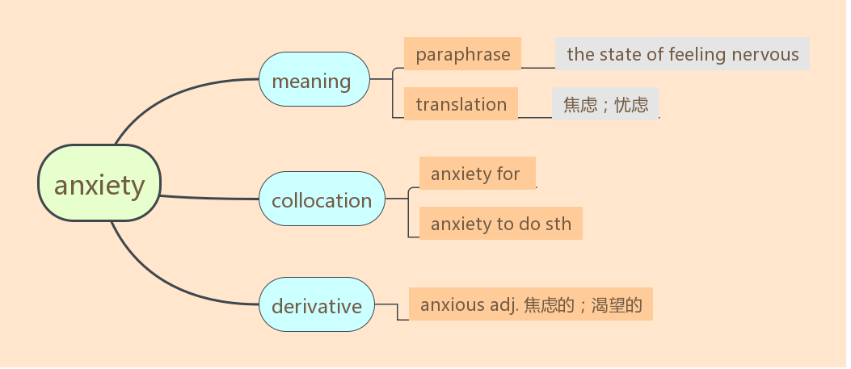
【用法小结】
be anxious about sth/for sb 为某事／某人担心
be anxious to do sth 渴望做某事
be anxious for sth 想要得到某物

Slide 41
【考点运用】
单句语法填空
It’s thought that one’s __________(anxious)often occurs as a result of his unsuccessful adaptation to the new surroundings.
（2）The audience is waiting__________ (anxious) to see which team will win.
（1）anxiety （2）anxiously
【例句仿写】
缺乏自信的学生回答问题时低着头，好像害怕把自己暴露在众人面前。
____________________________________________________________________
The students who lack confidence lower their head when answering the questions. It seems as if they are afraid of showing themselves in front of their classmates.

Slide 42
14.embarrassed adj. 难堪的；尴尬的；窘迫的；害羞的
【教材回扣】
They may also hide their faces in their hands like they are embarrassed or ashamed.
他们也会双手捂脸，一副尴尬或羞愧的样子。
【同义句替换】
__________________________________________________________________
They may bury their faces in their hands, looking awkward or ashamed.
【语境感知】
She is embarrassed about her height.
He felt embarrassed at being the centre of attention.
Some women are too embarrassed to consult their doctor about the problem.
I didn't want to embarrass her in front of her friends.
It’s not a good idea to criticize someone in front of others. This can cause embarrassment.(新外研必修三)

Slide 43
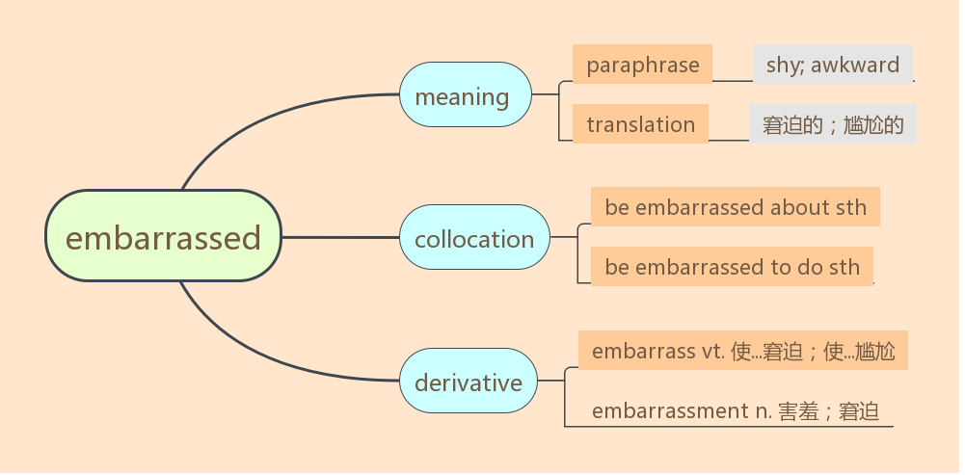
【用法小结】

Slide 44
【考点运用】
单句语法填空
(1) He was ___________(embarrass) to admit his mistake.
(2) His speech was followed by an ____________(embarrass) silence.
（1）embarrassed（2）embarrassing
【例句仿写】
有些学生不看老师，一副不喜欢老师的样子。
______________________________________________________________
Some students may not look at the teacher in the eye like they are not fond of their teacher.

Slide 45
15. ashamed adj. 羞愧；惭愧；尴尬；难为情的
【教材回扣】
They may also hide their faces in their hands like they are embarrassed or ashamed.
他们也会双手捂脸，一副尴尬或羞愧的样子。
【同义句替换】
___________________________________________________________________
They may bury their faces in their hands, looking awkward or ashamed.
【语境感知】
You should be ashamed of yourself for telling such lies.
I was too ashamed to tell her that I had failed.
Was he ashamed of having a friend like me? Bob longed for an answer.(新外研必修一)

Slide 46
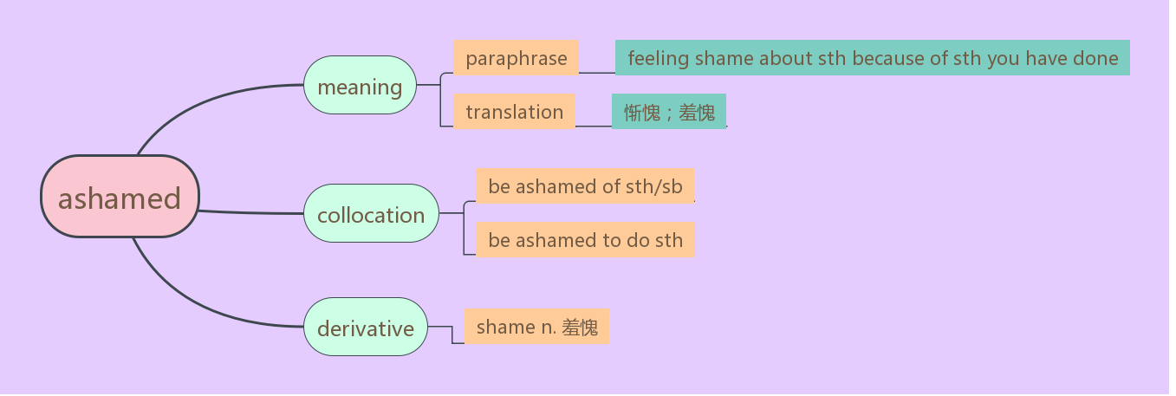
【用法小结】

Slide 47
【考点运用】
单句语法填空
He was so ashamed ___________his bad behavior.
He was ashamed __________(ask) such a simple question.
（1）of（2）to ask
16. bother vi. &vt. 费心；麻烦；因 . . . 操心； (使）烦恼； (使）担心
【教材回扣】
However, if a student doesn’t bother to brush her hair and her eyes are red from weeping, then I can infer that there are deeper issues at work.
但是，要是学生都懒得梳头，并且两眼因哭泣而发红，那么我能够推断她遇到了更为严重的问题。
【同义句替换】

Slide 48
I can realize that the student gets into trouble if he or she is unwilling to brush his or her hair and his or her eyes are red because he or she cries.
【语境感知】
It bothers me that he seems to take no interest in his work.
I'm sorry to have put you to all this bother.
Drop a piece of litter and can’t be bothered to pick up.(新北师必修三)
She added that it wasn’t only the water falling onto their balcony from Smith watering his plants that bothered them, but also the way he cleaned his fish tanks. (新北师选择性必修四)

Slide 49
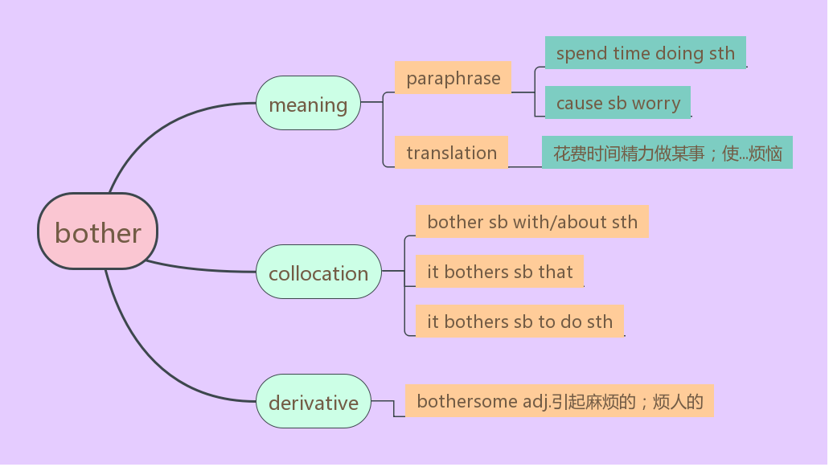

Slide 50
【考点运用】
单句语法填空
He didn’t want to bother her_______ those problems when she was on holiday.
__________ bothers me a lot that my best friend Tom has become addicted to playing computer games recently.
with （2）It
【例句仿写】
如果学生不愿意跟任何人交流，那么我可以判断他可能遇到大麻烦了。
_________________________________________________________________________
If a student is unwilling to communicate with anyone, then I can draw the conclusion that he or she may get into big trouble.

Slide 51
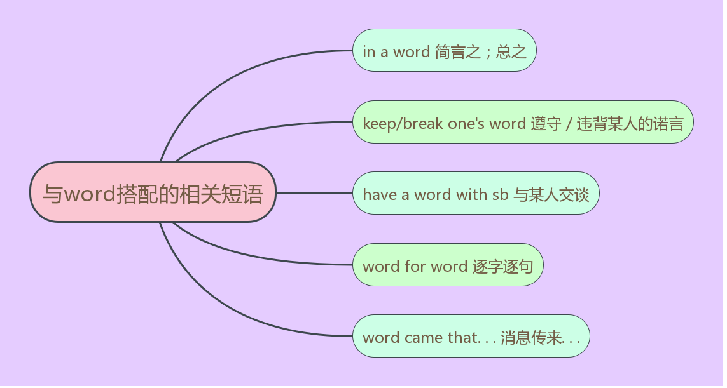
17.in other words 换句话说；也就是说
【语境感知】
New research has found that animals have memories, too. In other words, they might be much cleverer than we thought.
新的研究发现，动物也有记忆。换句话说，它们可能要比我们想的聪明得多。
You can organize your work or studies. In other words, you can make a list and do all the important things first.(新北师必修一)
【用法小结】

Slide 52
【考点运用】
完成句子
_________, I love my school. I find my school life more and more meaningful and colourful.
总之，我爱我的学校，我发现我的学校生活越来越有意义，越来越多姿多彩。
（2）He failed to hold back his tears when ____________ his father passed away.
听到父亲去世的消息，他忍不住流下了眼泪。
（1）In a word（2）word came that
18. by comparison 相比之下；比较起来
【教材回扣】
By comparison, in Bulgaria and southern Albania, the gestures have the opposite meaning.
相比之下，在保加利亚和阿尔巴尼亚南部，这两个姿势的含义正好相反。
【同义句替换】
______________________________________________________________________

Slide 53
By contrast, the gestures in Bulgaria and southern Albania are contrary to those in other countries.
【语境感知】
In comparison with last year, the price of beef has increased.
In comparison with other species, cloning primates has proved to be “much harder”.(新北师选择性必修三)
Mike’s new house is like a huge palace, compared to his old one.
I often compare what I think with others’ opinions.

Slide 54
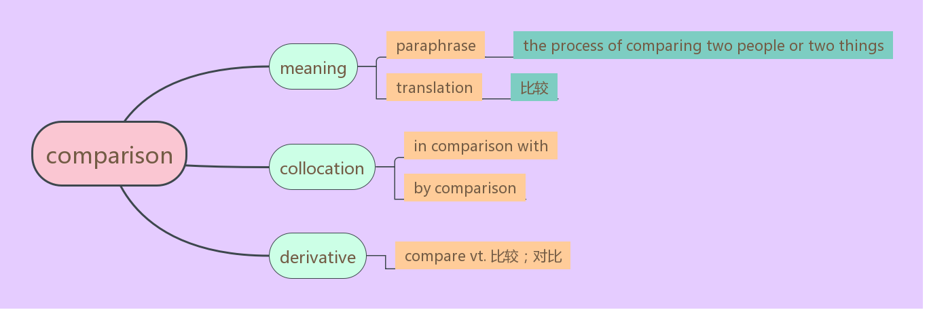
【用法小结】

Slide 55
【考点运用】
单句语法填空
In the forest, sound is a better means of communication over distance in _________ (compare) with light.
(2)Lily does well in her studies, especially in maths and English. No one in our class can compare ________ her.
comparison（2）with

Slide 56
【例句仿写】
相比之下，有些学生渴望在同学们面前表现自己。
_________________________________________________________________________
By comparison, some students are eager to show themselves in front of their classmates.
19.call on 访问；要求（某人讲话等）
【教材回扣】
We intended to visit the theme park but ended up calling on Professor Zhang.
我们原打算参观主题公园，但最后拜访了张教授。
【同义句替换】
_________________________________________________________________________

Slide 57
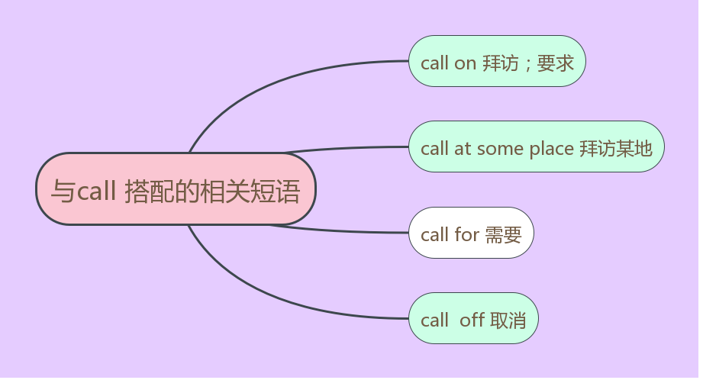
We had planned to visit the theme park but at last we paid a visit to Professor Zhang.
【语境感知】
I am going to call on one of my former college classmates this weekend.
Not knowing his address, I can’t call on him.
Now, let’s call on the chairman to address the meeting.
【用法小结】

Slide 58
【近义短语】
drop in on 拜访
pay a visit to 访问;参观
【考点运用】
翻译句子
如果周末有空的话，我会去拜访你。
_________________________________________________________________
政府号召我们过低碳生活。
_________________________________________________________________
(1)If I am available at weekend, I will call on you.
（2）Our government calls on us to lead a low-carbon life.

Slide 59
20. adjust vt. 调整；调节 vi. &vt. 适应； (使）习惯
【教材回扣】
Their body language lets me know when to adjust class activities, when to intervene, and when to talk to students individually, so they can all get the most out of school.
他们的肢体语言让我知道该何时调整课堂活动、何时干预、何时与学生单独谈话，从而让他们在校收获最大。
【同义句替换】
_______________________________________________________________________
By watching their body language, I know when to interact with my students so that they can learn best in school.

Slide 60
【语境感知】
However, we will adjust the influence.
（2020年新高考全国I，阅读理解D）
When Riley moves to a new city, she has a hard time adjusting to her new surroundings.(新北师选择性必修三)
【用法小结】

Slide 61
【考点运用】
单句语法填空
My parents had trouble adjusting to _________ (live) in an apartment.
The seats are __________ (adjust); that is to say, you can adjust them to a certain angle or height.
(1) living （2）adjustable

Slide 62
【例句仿写】
教师应该多观察学生在课堂上表现出的肢体语言，以便更好地了解学生。
____________________________________________________________________
Teachers should spend more time observing the students’ body language in class so that they can have a better understanding of the students.

Slide 63
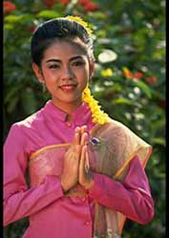
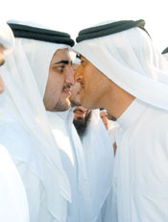
Summary
Write a short passage to show your understanding of body language.

Slide 64
One possible version:
Body language forms a major part of communication. That means people pick more from non-verbal communication than from the words. Therefore, when studying about a foreign culture, it just makes sense to pay attention to how people use non-verbal cues.
Sometimes we have interactions with others by using eye contact. But in some cultures, it is not allowed.The gesture for “OK” varies in different cultures. In China, it means agreement. By comparison, using the gesture for “OK” is not approved of in Brazil and Germany. In some places, people favour hugging each other when they meet.Which way do Japanese prefer to use to show their greetings when they meet, bowing or kissing on the cheek? The answer is that they prefer the latter.

Slide 65
Speaking of body language in classroom, I have a lot to share. The students’ body language vary based on how they feel in class. When a student shows great interest in what the teacher says, he may open his eyes wide and look at the teacher in the face.When a student feels bored in class, he or she will look around.Some students may not look at the teacher in the eye like they are not fond of their teacher.With blank expressions on their face, some students are occupied in letting their minds wandering. The students who lack confidence lower their head when answering the questions. It seems as if they are afraid of showing themselves in front of their classmates. By comparison, some students are eager to show themselves in front of their classmates. If a student is unwilling to communicate with anyone, then I can draw the conclusion that he or she may get into big trouble.

Slide 66
While teachers can be aware of how students feel in class by observing their expressions on their faces, it is still a little tough to perceive what they think.Teachers should spend more time observing the students’ body language in class so that they can have a better understanding of the students.

Slide 67
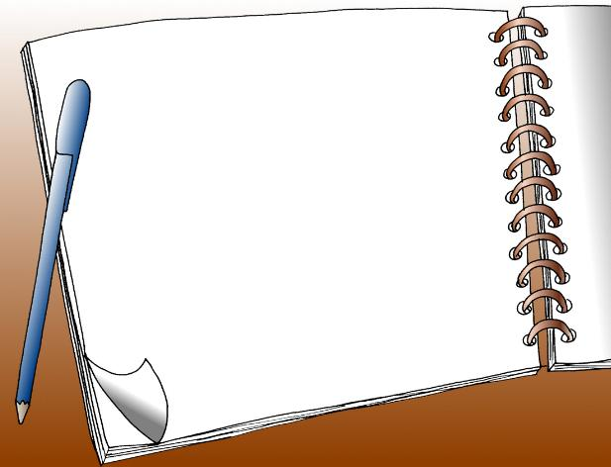
核心素养专练
Finish off the exercises on the handout.

Slide 68
Thank you !

