Slide 1
Unit 4 Body Language Reading for Writing

Slide 2
Teaching objectives:
By the end of this period, you will be able to
1. have a good understanding of the body language in classroom.
2. figure out the basic structure of the text.
3. write a passage to describe the body language of the person in your drawing.

Slide 3
Leading in
How do you feel today?

Slide 4
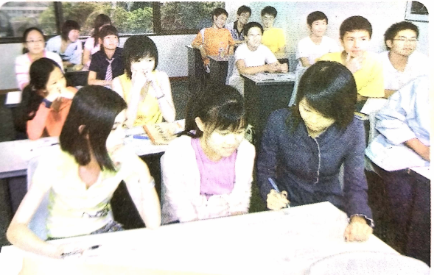
Reading for main idea.
Read the passage quickly and summarize the main idea.
The passage mainly tells us that teachers can observe
students’ body language to adjust their teaching activities.

Slide 5
Reading for structure
Activity 1
Read the text quickly and fill out the following chart.
Paragraph | Main idea
Paragraph 1 and 2
Paragraph 3
Paragraph 4
Paragraph 5
Paragraph 6

Slide 6
Paragraph | Main idea
Paragraph 1 and 2 | Introduction of the topic
Paragraph 3 | Recognize when students are interested or bored
Paragraph 4 | Recognize when students are distracted
Paragraph 5 | Distinguish when students are troubled
Paragraph 6 | Conclusion

Slide 7
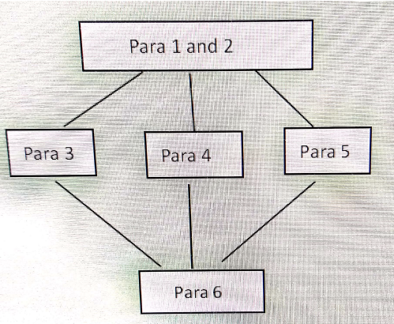
Activity 2 Draw the mind map to show its structure.

Slide 8
Reading for detailed information
Activity 1 Match the body language with the meanings.
__________ 1 Looking up and making eye contact A very interested
__________ 2 Leaning over to look at one’s watch B bored
__________ 3 Two friends leaning heads together C interested
__________ 4 Leaning forward and looking at the teacher D sad or worried
__________ 5 Looking up but no eye contact, no expression E distracted
__________ 6 Looking away F writing notes
__________ 7 Chin on hand, looking out the window G serious problems
__________ 8 Looking down, arms or legs crossed H like they are asleep
__________ 9 Frowning I daydreaming
__________ 10 Hair not brushed, red eyes J angry, afraid, or experiencing anxiety
C 2. B 3. F 4. A 5. H 6. E 7. I 8.D 9. J 10.G

Slide 9
Activity 2 Read the text once again and answer the questions.
How does the teacher know what students are thinking?
______________________________________________________________________
2.According to the teacher, what is some students’ favorite activity?
________________________________________________________________________
3.What does the phrase “who knows what ”mean?
________________________________________________________________________
4. Why does the teacher think body language is important?
_________________________________________________________________________
By looking at their body language.
Daydreaming.
It is impossible to tell what they are interested in.
Students’ body language lets the teacher know when to adjust class activities, when to intervene, and when to talk to students individually, so they can all get the most out of school.

Slide 10
Practicing describing the body language in the photos.
In groups, discuss what these people are doing and what their body language is telling you.

Slide 11
It looks like the teacher is pointing at a male student, who is looking up with a serious expression on his face. I think the teacher is scolding him for something. Meanwhile, the girl in the back of the photo is hiding her mouth with her hand, and from her eyes, it looks like she is smiling. Perhaps she is happy that the other student is being scolded
2.The boy is giving a first pump and smiling. This is normally done when someone has just accomplished something good and wants to celebrate.
3. The boy is telling a joke to the girl in secret, and she is hiding her face because she is laughing.

Slide 12
Writing
Activity 1 Draw someone you know. Show his body language in your drawing.
Activity 2 Write a passage to describe the body language of the person in your drawing.

Slide 13
One possible version:
This is my friend Tom. He is bending and drawing with a pencil in his hand. His other hand holds an eraser, because he wants to use it as soon as he needs it without wasting time. Tom is a very serious artist, which you can tell from the intense look on his face. When he is drawing, he tends to focus all his attention on it. It is often the case that when other people call out his name, he does not even hear them because he is lost in his art world.

Slide 14
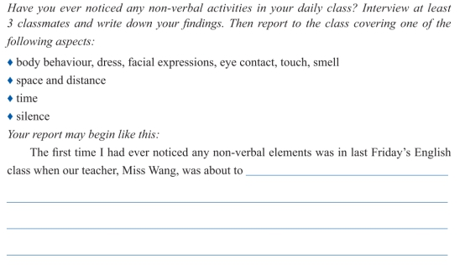
核心素养提升

Slide 15
Thank you !
Have a nice day!

