Slide 1
Unit 4 Body Language
Reading and Thinking 02

Slide 2
Teaching objectives:
By the end of this period, you will be able to…
1. get a better understanding of body language.
2. identify the feature of body language---cultural-specific.
3. develop the sense of cross-cultural communication.

Slide 3
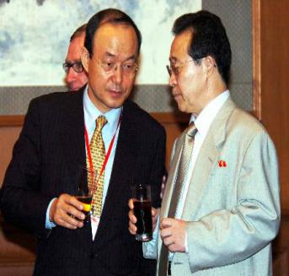
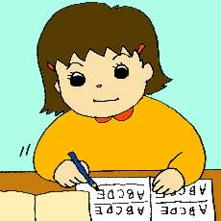
Lead in
Activity 1 Look at the following picture and think about the question: How do people communicate with others?
By speaking
By ringing
By writing

Slide 4
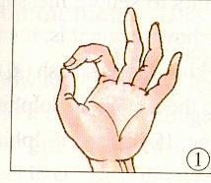
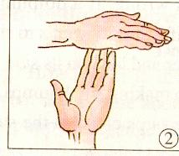
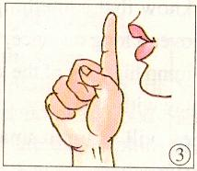
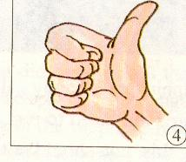
Activity 2 Guessing game
What do the gestures mean?
OK
Stop
Silent
Well-done

Slide 5
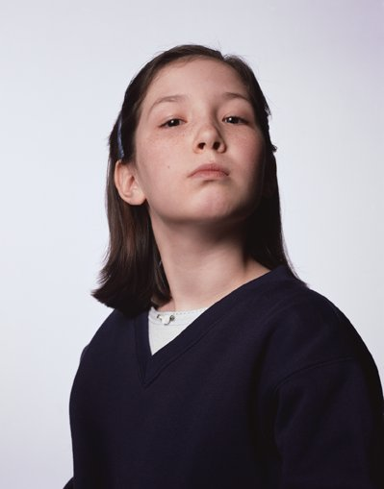

Read for the type of writing
Look through the text and find out the type of writing.
A. Narration
B. Exposition
C. Argumentation

Slide 6
Read for the main meaning of the text
Match each paragraph with its main idea.
Para1 A. Body language varies in different cultures.
Para2 B. Body language can show our feelings.
Para3 C. The gestures for “yes” and “no” are different.
Para4 D. The different meanings of “OK”.
Para5 E. Smiling has many different uses.
Para6 F. Some gestures with the same meaning
Para1---6 BADCFE

Slide 7
Scanning for specific information
Activity 1 Scan the text and find out the following information.
Body language/Gesture | Meaning | Country/Region
Eye contact between men and women | Not polite | Middle East
Looking down when talking to someone
OK sign
Kissing on the cheek
Placing your hands together and resting them on the side of your head while closing your eyes
Moving your hand in circles over your stomach after a meal

Slide 8
Body language/Gesture | Meaning | Country/Region
Eye contact between men and women | Not polite | Middle East
Looking down when talking to someone | Respect | Japan
OK sign | Money Zero Not polite | Japan France Brazil and Germany
Kissing on the cheek | Greeting | France and Russia
Placing your hands together and resting them on the side of your head while closing your eyes | Sleep | everywhere
Moving your hand in circles over your stomach after a meal | Full | everywhere

Slide 9
Activity 2
Complete the following sentences using the information in the box.
making eye contact
talking to an older person
watching their body language
moving your hand in circles over your stomach
encountering an identical gesture
making the gesture for “OK” in Brazil and Germany
We can learn a lot about what people are thinking by______________.
For example, ___________ ---looking into someone’s eyes--- in some countries is a way to display interest.
In Japan, it may demonstrate respect to look down when___________.
In France, a person _________ may interpret it as meaning zero.
However, you should avoid_________, as it is not considered polite.
A good way of saying “I am full” is ______________after a meal.
1--6 CABEFD

Slide 10


Discuss and Debate
Which is more reliable guide for understanding someone’s feelings, their body language or the words they speak?
Debate:
Pros (正方)：…
Cons (反方): …

Slide 11
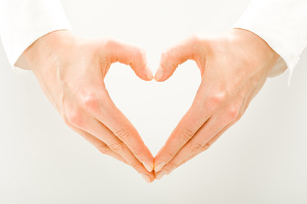
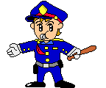
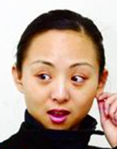
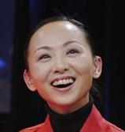
Practice
Activity 1
Act and guess. Three students come to the front and act respectively, the other students guess what he or she means.

Slide 12


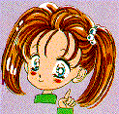
Activity 2 Sing the following song and perform the body language.
If you’re happy and you know it clap your hands
If you're happy and you know it clap your hands
If you're happy and you know it never be afraid to show it
If you're happy and you know it clap your hands
If you're happy and you know it stamp your feet
If you're happy and you know it stamp your feet
If you're happy and you know it Never be afraid to show it
If you're happy and you know it stamp your feet
If you're happy and you know it wink your eyes
If you're happy and you know it wink your eyes
If you're happy and you know it never be afraid to show it
If you're happy and you know it wink your eyes

Slide 13
核心素养提升
Search the Internet to find more information about body language and make a PPT to show your work.

Slide 14
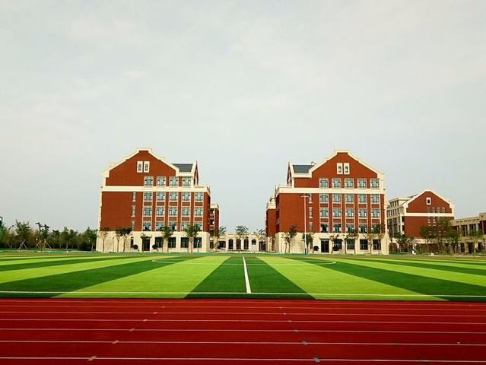
Thank you !
Have a nice day!

